Slide 1
Tools – Hand and Power
10-Hour Construction Outreach

Slide 2
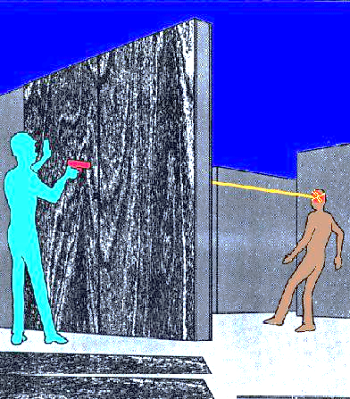
Introduction
Fatal Facts:
Employee killed when struck in head by a nail fired from a powder-actuated tool.
Source: OSHA
Notes:
Fatal Facts
A 22-year-old carpenter’s apprentice was killed when he was struck in the head by a nail fired from a powder-actuated nail gun. The nail gun operator fired the gun while attempting to anchor a plywood concrete form, causing the nail to pass through the hollow form. The nail traveled 27 feet before striking the victim. The nail gun operator had never received training on how to use the tool, and none of the employees in the area was wearing PPE.

Slide 3
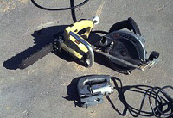
Introduction
Tools are part of our everyday lives.
Even simple tools can be hazardous.
Source: OSHA
Notes:
Hand and power tools are a part of our everyday lives. These tools help us to perform tasks that otherwise would be difficult or impossible. However, even simple tools can be hazardous, and have the potential for causing severe injuries when used or maintained improperly. Special attention toward hand and power tool safety is necessary in order to reduce or eliminate these hazards.

Slide 4
Introduction
Objectives:
Identify various types of tools.
Describe types of hazards.
Describe guarding requirements.
Describe safe operation methods.
Recognize employer requirements.
Notes:
Upon successful completion of the topic, participants will be able to:
Identify various types of tools commonly used at construction worksites.
Describe types of hazards associated with the use of tools.
Describe guarding requirements for various types of tools.
Describe safe operation methods while working with various types of tools.
Recognize employer requirements to protect workers from tool hazards.

Slide 5
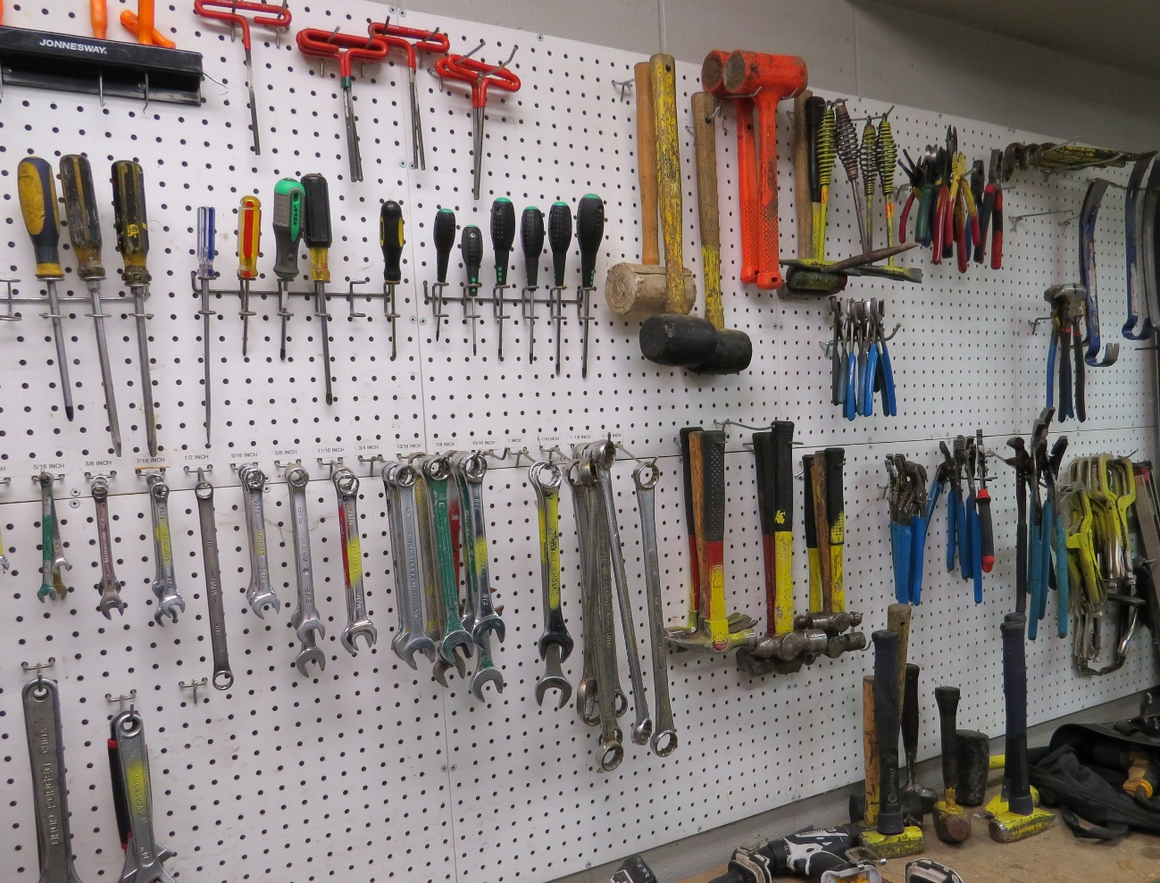
Types of Tools
Manually operated hand tools
Source: TEEX
Notes:
Examples:
Wrenches
Impact tools – drift pins, wedges, chisels
Hammers
Screw drivers

Slide 6
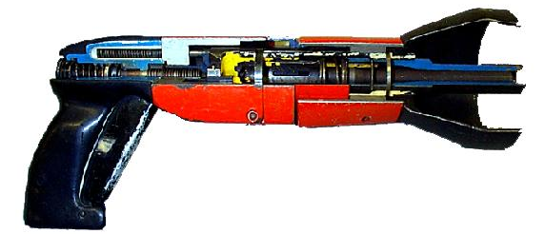

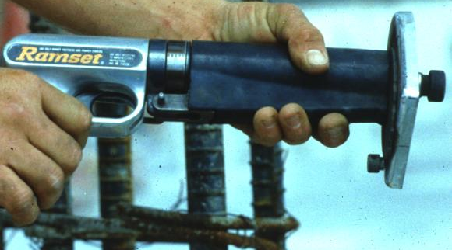
Types of Tools
Power-operated tools
  Electrical
  Pneumatic
  Liquid fuel
  Hydraulic
  Powder-actuated
Source of photos: OSHA
Notes:
Examples:
Electrical – cord or battery provides electrical power; Examples: drills, saws, grinders
Pneumatic – powered by compressed air; Examples: chippers, drills, hammers, and sanders
Liquid fuel – powered by fuel, usually gasoline; Examples: chainsaw, weed-eater, drills, blowers, edgers, and augers
Hydraulic – fluid provides medium for power transfer; Example: hydraulic jacks
Powder-actuated – operates like a loaded gun; Example: nailer, riveter, framing tool, and other fastener tools

Slide 7

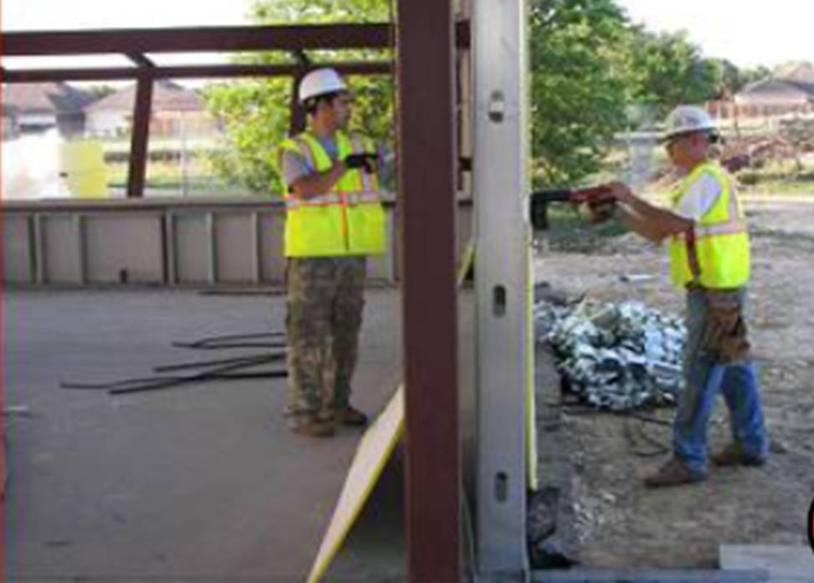
Hand and Power Tool Hazards
Types of hazards
  Struck-by
  Electrical
  Caught-in
Source: OSHA
Source: Susan Harwood Grant Number
SH-17792-08-60-F-48 by Compacion Foundation
Notes:
Hazards:
Struck-by due to flying, falling, impact, or abrasive objects
Electrical shock or electrocution
Caught-in hazards with tools that have moving parts
Photos:
Top right - shows entrance wound and thermal burns a worker received when he was shocked by an overheated tool that he was holding.
Bottom left – shows hazardous situation that could occur when using powder-actuated tools to drive fasteners into materials. If material is easily penetrated, the worker on the other side of the wall is at risk of being struck by flying objects.

Slide 8

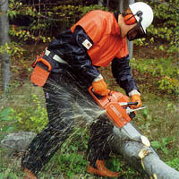
Hand and Power Tool Hazards
  Harmful materials
  Trips and slips
  Sharp edges/protruding objects
Source: OSHA, courtesy of New Jersey Department of Health
Source: OSHA
Notes:
Hazards:
Exposure to harmful dusts, fumes, mists, vapors, or gases
Trips and slips – housekeeping issues, cords and hoses, tools left lying around, etc.
Contact with sharp edges or protruding objects that cause cuts, punctures, or contusions
Photos:
On left – worker cutting through cinder block is exposed to silica dust.
On right – worker using chainsaw is potentially exposed to the sharp edges of the cutting chain; additional hazards include flying particles and noise.

Slide 9
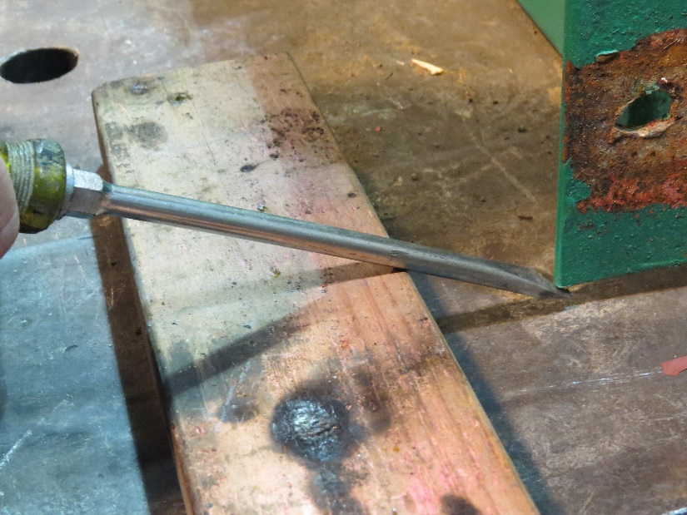
Hand and Power Tool Hazards
Exposure to hazards due to using
  Wrong tool
  Tool wrong way
Source: TEEX
Notes:
Exposure to hazards occur when a worker:
Uses the wrong tool for the job.
Uses a tool the wrong way.
Photos:
Worker is using a screwdriver as a pry bar, a task for which it was not designed.

Slide 10
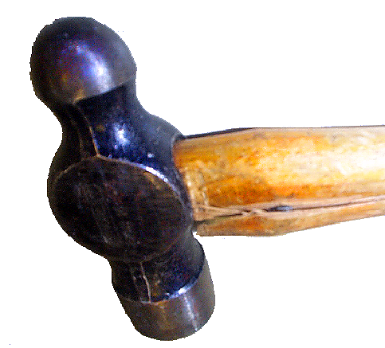
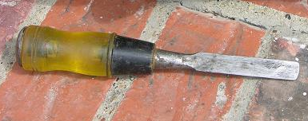
Hand and Power Tool Hazards
  Damaged or broken tools
  Dull tools
Source: OSHA
Source: TEEX Harwood
Notes:
Exposure to hazards occur when a worker:
Uses damaged or broken tools.
Uses tools that are dull.
Photos:
On left – cracked handle on hammer; do not use damaged tools
On right – chisel rounded on corners

Slide 11
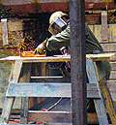
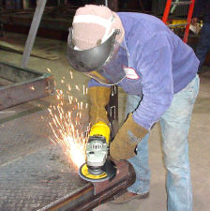

Hand and Power Tool Hazards
  Spark-producing tools near flammable sources
  Tools not properly guarded
  Tools not properly grounded
  Inadequate PPE
Source: OSHA
Source: TEEX Harwood
Source: OSHA
Notes:
Exposure to hazards occur when a worker:
Uses spark-producing tools near flammable sources.
Uses tools not properly guarded.
Photos:
On left – tools that produce sparks when used, such as a grinder, should not be used around flammable sources.
In middle – there is no guard on circular saw to prevent exposure to cutting blade.
On right – worker is wearing proper PPE, including eye and face protection, while grinding.

Slide 12


Guarding
Use guarding techniques for hazards
  Motions: rotating, in-running nip points, reciprocating, transversing
  Actions: cutting, punching, shearing, bending
Source of photos: OSHA
Notes:
Photos:
On left – nip points occur between rotating and fixed parts, such as the area where the rotating abrasive wheel meets the work rest and tongue.
On right – rotating, reciprocating, or transverse motions in cutting actions can create hazards at the point of operation or with flying particles.

Slide 13
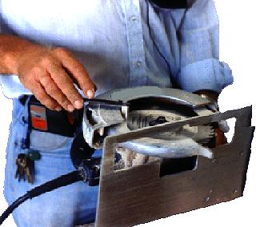
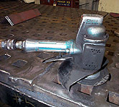
Guarding
Guard
  Exposed moving parts
  Point of operation, in-running nip points, and rotating parts
  Flying chips and sparks
  Abrasive wheels and cutting blades
  Never remove guards when tool is in use
Source of photos: OSHA
Notes:
Guarding techniques:
Guard exposed moving parts of power tools.
Guard belts, gears, shafts, pulleys, sprockets, spindles, flywheels, chains, or other moving parts.
Never remove a guard when a tool is in use.
Guard the point of operation, in-running nip points, and rotating parts.
Guard the operator and others from flying chips and sparks.
Appropriate guards must be in place to prevent operator from coming in contact with saw blades.
Guard an abrasive wheel so that the minimal amount of the wheel is exposed, and ensure the guard is properly aligned with the wheel.
Photos:
On left – portable circular saw with upper and lower guards in place.
On right – hand-held grinder with guard.

Slide 14
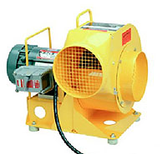
Guarding
Properly guarded blower
Source: OSHA

Slide 15
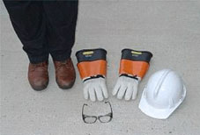
Precautions for Safe Use
General hand and power tool safety practices
  Keep tools clean and well-maintained.
  Use the right tool and use it the right way.
  Follow manufacturer’s instructions.
  Wear proper PPE
Source: OSHA
Notes:
Basic hand and power tool safety practices:
Always keep tools in good condition with regular maintenance.
Use the right tool for the job. Use the tool that was designed for the job and use it the right way.
Examine each tool for any damage before using it and, if the tool is damaged, don’t use it.
Follow manufacturers’ instructions when using tools and use them the right way. This includes using the guards that are part of a tool.
Always wear the right PPE and use it properly.
Photo: select appropriate PPE for the task, such as footwear, hand protection, head and face protection, eye protection, hearing protection, and respiratory protection.

Slide 16
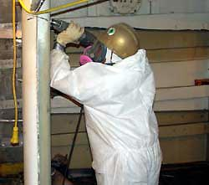
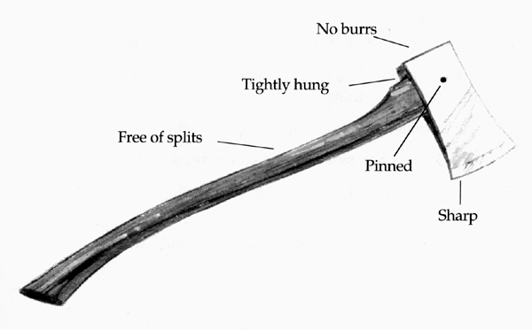
Precautions for Safe Use
  Practice good housekeeping.
  Keep work areas well lit.
  Inspect tools; remove from service if needed.
  Keep all cutting tools sharp
Source: OSHA
Notes:
Precautions for all hand and power tools
Keep the floors in the work clean and free from any debris that could cause tripping or slipping.
Keep work areas well lit.
Inspect all tools for defects and remove any broken or damaged tools from service.
Photo:
On left - worker wearing full-face respiratory protection, hard hat, and protective clothing while operating a portable electric reciprocating saw.
On right - both hand tools and power tools need to be well-maintained, inspected, and removed from service if damaged.

Slide 17
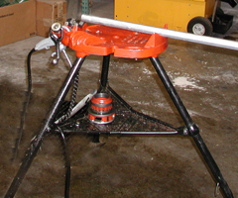
Precautions for Safe Use
Precautions for power tools
  Disconnect from power source.
  Keep people at safe distance.
  Secure work.
Source: OSHA
Notes:
Precautions for power tools:
Disconnect tools from power source when not in use, before servicing and cleaning them, and when changing accessories such as blades, bits, and cutters.
Keep all people not involved with the work at a safe distance from the work area.
Secure work with clamps or a vise so that both hands are free to operate the tool.
Photo: shows vice mounted on a three-legged stand.

Slide 18
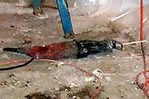
Precautions for Safe Use
  Avoid accidental start-ups.
  Fit with guards and safety switches.
  Maintain good footing and balance.
  Wear proper clothing for task.
  Safeguard exposed moving parts
Source: OSHA
Notes:
Precautions for power tools:
Avoid accidental starting; do not hold fingers on the switch button while carrying a tool that is still attached to its power source.
Power tools must be fitted with guards and safety switches.
Be sure to maintain good footing and balance when operating power tools.
Wear proper clothing for the task; do not wear loose clothing, ties, or jewelry when working in an area or a tool that has moving parts.
Safeguard exposed moving parts of power tools, including belts, gears, shafts, pulleys, sprockets, spindles, drums, flywheels, chains, or other reciprocating, rotating, or moving parts of equipment.
Photo: shows reciprocating saw with deadman switch.

Slide 19

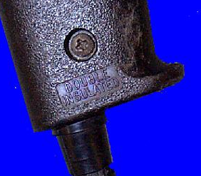
Precautions for Safe Use
Electrical tools:
  Remove from service and tag damaged tools
  Protect against shock
  Never remove third prong
Source: NIOSH
Source: OSHA
Notes:
Electric tools safety practices:
Electric tools that are damaged must be removed from service and tagged “Do Not Use.”
To protect a worker from shock, electrical tools must:
have a three-pronged plug that is used with a grounded receptacle;
be double-insulated; or
be powered by a low-voltage isolation transformer
Never remove the third prong (grounding pin) from a three-prong plug. An adapter may be used to accommodate a two-prong receptacle, but it must be attached to a known ground.
Photos:
On left: Shows use of grounded electrical device (receptacle and 3-prong plug).
On right: Shows stamp of a double-insulated electric power tool.

Slide 20
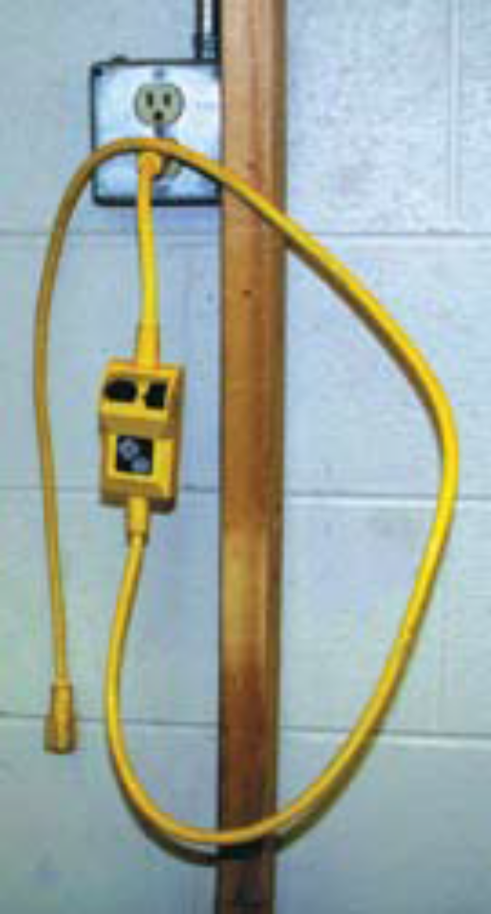
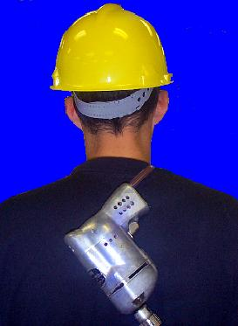
Precautions for Safe Use
  Protect cords
  Store properly
  Use GFCI or AEGC
Source: OSHA
Source: NIOSH
Notes:
Electric tools safety practices:
Do NOT:
pull cords to disconnect tool from outlet
use cords to hoist or lower tools
carry portable tools by the cord
run cords across walkways and traffic areas
Keep cords and hoses away from heat, oil, and sharp edges.
Store electrical tools in a dry place and do NOT use in damp or wet locations, unless they are approved for that purpose.
Use Ground Fault Circuit Interrupter (GFCI) or Assured Equipment Ground Conductor (AEGC) program.
Photos:
On left – shows electric power tool being carried improperly by cord.
On right – shows portable GFCI.

Slide 21


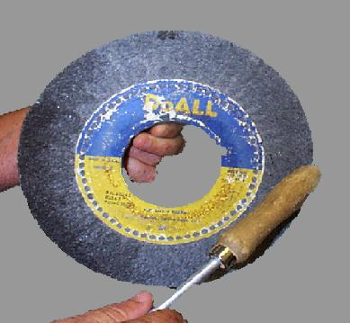
Precautions for Safe Use
Abrasive wheels and tools
  Equip with guards.
  Before mounting, inspect and test.
  Follow manufacturer recommendations for operating speeds.
Source of photos: OSHA
Notes:
Precautions with abrasive wheels and tools:
Equip with guards that:
cover the spindle end, nut, and flange projections;
maintain proper alignment with the wheel; and
do not exceed the strength of the fastenings.
Before an abrasive wheel is mounted:
inspect it for damage; and
sound- or ring-test it to ensure that it is free from cracks or defects.
Follow manufacturer recommendations for operating speeds.
Photos:
On left – abrasive wheel equipped with guards and work rest.
In middle – ring test abrasive wheel before mounting:
1910.215(d)(1)
Inspection. Immediately before mounting, all wheels shall be closely inspected and sounded by the user (ring test) to make sure they have not been damaged in transit, storage, or otherwise. The spindle speed of the machine shall be checked before mounting of the wheel to be certain that it does not exceed the maximum operating speed marked on the wheel. Wheels should be tapped gently with a light nonmetallic implement, such as the handle of a screwdriver for light wheels, or a wooden mallet for heavier wheels. If they sound cracked (dead), they shall not be used. This is known as the "Ring Test".
1910.215(d)(1)(i)
Wheels must be dry and free from sawdust when applying the ring test, otherwise the sound will be deadened. It should also be noted that organic bonded wheels do not emit the same clear metallic ring as do vitrified and silicate wheels.
On right – maximum speed as indicated by manufacturer on abrasive wheel.

Slide 22
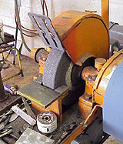
Precautions for Safe Use
  Accelerate wheel to operating speed before beginning task.
  Do not stand in front of grinding wheel as it comes up to speed.
  Properly adjust
  (1/8” opening) and use work rest.
Source: OSHA
Notes:
Precautions with abrasive wheels and tools:
Allow the abrasive wheel to accelerate to operating speed before beginning grinding or cutting work to prevent disintegration or explosion during start-up.
Do not stand in front of the grinding wheel as it comes up to speed; use eye and/or face protection.
Properly adjust the work rest on grinding tools and use it to support the work and prevent it from being jammed. “Work rests shall be kept adjusted closely to the wheel with a maximum opening of one-eighth inch” [1910.215(a)(4)].
Photo: Shows proper guarding of wheel and correctly adjusted work rest on bench grinder.

Slide 23
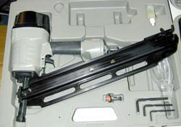
Precautions for Safe Use
Pneumatic tools
  Use same precautions with air hose as with electric cords
  Securely fasten air hose to tool and safeguard with a positive locking device
Source: OSHA
Notes:
Precautions for safe use of pneumatic tools:
Use same precautions with air hose as with electric cords.
Do not use hose to hoist or lower tools.
Do not carry portable tools by the hose.
Do not run hose across walkways and traffic areas.
Keep away from heat, oil, and sharp edges.
Check that the tool is fastened securely to the air hose to prevent them from being disconnected and use a positive locking device as an added safeguard.
Photo: pneumatic tool

Slide 24
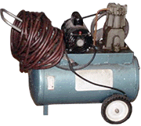
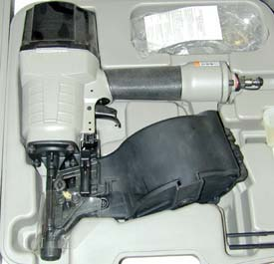
Precautions for Safe Use
  Equip tool with device to keep fasteners from accidently being ejected.
  Use screens to protect nearby workers.
  No not use compressed air for cleaning off clothing.
Source of photos: OSHA
Notes:
Precautions for safe use of pneumatic tools:
Pneumatic tools that shoot nails, rivets, staples, or similar fasteners must be equipped with a special device to keep fastener from being accidently ejected.
Screens must be set up to protect nearby workers from being struck by flying fragments.
Do not use compressed air for cleaning off clothing and never point compressed air guns at anyone.
Photos:
On left – pneumatic nailer
On right – air compressor

Slide 25
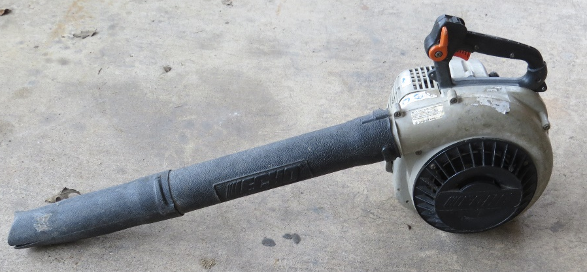
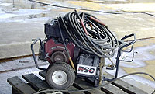
Precautions for Safe Use
Fuel-powered tools
  Handle, transport, and store gas or fuel
  in approved containers.
  Shut down and allow engine to cool before refilling fuel tank.
  Use ventilation and respiratory protection as needed.
Source: TEEX
Source: OSHA
Notes:
Precautions for safe use of fuel-powered tools:
Handle, transport, and store gas or fuel in approved flammable liquid containers only.
Shut down the engine and allow it to cool before refilling a fuel-powered tool tank.
Provide satisfactory ventilation or appropriate respiratory protection when using these tools inside a closed area.
Photo:
On left – fuel-powered blower
On right – workers may be exposed to toxic gases (carbon monoxide, nitrogen oxides, or diesel exhausts) when operating portable equipment with internal combustion engines in enclosed or confined spaces.

Slide 26
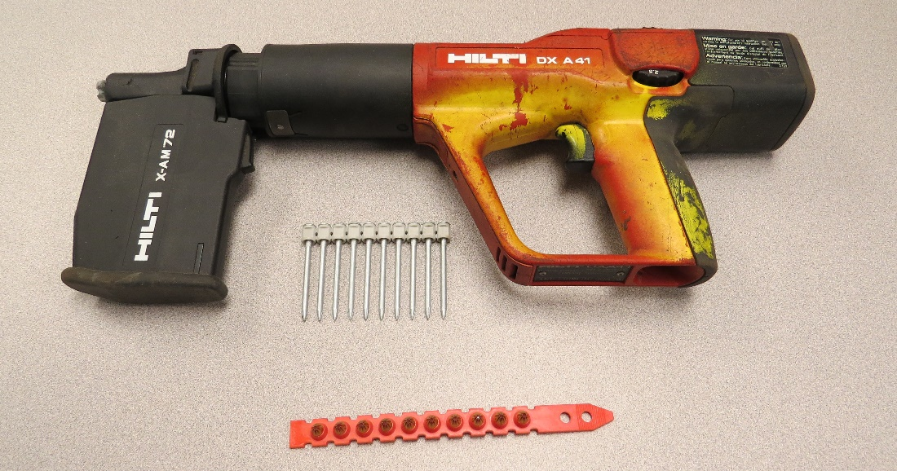
Precautions for Safe Use
Powder-actuated tools
  Treat with extreme caution
  Must be trained and licensed
  Wear suitable PPE
Source: TEEX
Notes:
Precautions with powder-actuated tools:
Need to be treated with extreme caution, like a loaded gun
Must be trained and licensed to use them
Wear suitable ear, eye, and face protection.
Photo: powder-actuated nail gun, nails, and powder

Slide 27

Precautions for Safe Use
  Select appropriate powder level for tool and task
  Test tool to ensure safety devices work
  Inspect tool
  Do not use defective tools
Source: TEEX
Notes:
Precautions with powder-actuated tools:
Select either a high-velocity or low-velocity powder level that is appropriate for the tool and task without applying excessive force.
Test the tool each day before loading to ensure the safety devices are working properly.
Inspect tool before each use to make sure that it is clean, the moving parts operate freely, the barrel is free from obstructions, and the proper shield, guard, and attachments are in place.
Immediately remove from service any defective tool and do not use until properly repaired.
Photo: powder-actuated tool

Slide 28
Precautions for Safe Use
  Do not load tools until just prior to use
  Never point tool at anyone
  Keep hands clear of open barrel end
  Never leave loaded tool unattended
  Do not drive fasteners into materials that are very hard, brittle, or easily penetrated
  Do not drive fastener into a spalled area
  Use manufacturer-recommended shields, guards, or attachments.
  Store unloaded in a locked box.
Notes:
Precautions with powder-actuated tools:
Do not load tools until just prior to use.
Never point the tool (loaded or empty) at any employee.
Keep hands clear of the open barrel end.
Never leave loaded tools unattended.
Do not drive fasteners into very hard or brittle materials; and, avoid driving into easily penetrated materials unless they are backed by an impenetrable backing.
Do not drive fastener into a spalled area.
Do not use tools in an explosive or flammable atmosphere.
Use manufacturer-recommended correct shield, guard, or attachment on tools.
Store tool unloaded and in a locked box.

Slide 29
Employer Requirements
Comply with OSHA standards
  Training
  Inspection
Comply with manufacturer’s requirements and recommendations

Slide 30

Identify Hazards
Hand-held sander with exposed wires should not be used.
Source: NIOSH

Slide 31
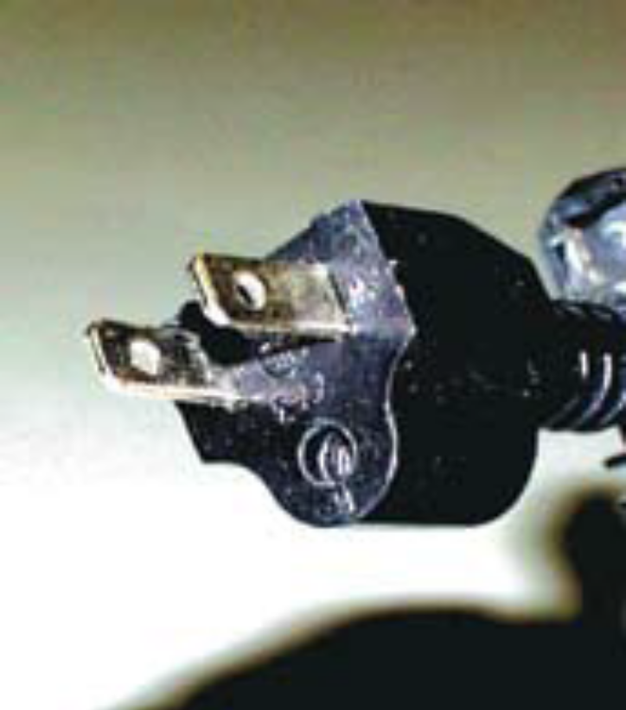
Identify Hazards
This three-prong grounding plug has the ground prong broken off.
Source: NIOSH

Slide 32
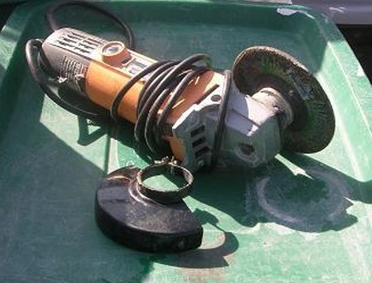
Identify Hazards
Grinder guard removed to accommodate larger wheel.
Source: TEEX Harwood

Slide 33
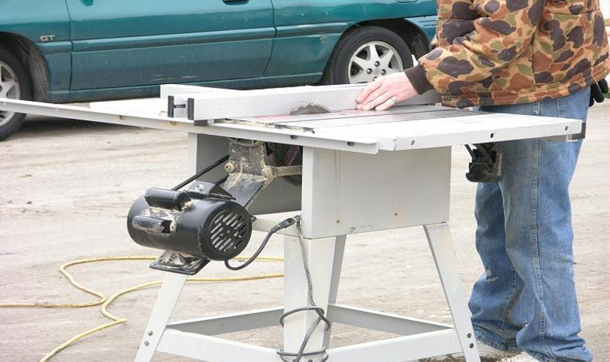
Identify Hazards
Working in street with power cords potentially exposed to traffic.
Guard removed from saw blade.
Power take-off guard is missing.
Source: TEEX Harwood

Slide 34
Knowledge Check
Which of the following is an example of an unsafe practice regarding the use of tools?
  Keeping cutting tools sharp
  Wearing eye and face protection while operating a grinder
  Using a screwdriver to carve or cut wood
  Following manufacturer’s instructions when using a tool
c. Using a screwdriver to carve or cut wood

Slide 35
Knowledge Check
Which term describes a tool that is powered by compressed air?
  Hydraulic
  Powder-actuated
  Electrical
  Pneumatic
d. Pneumatic

Slide 36
Knowledge Check
Which of the following actions may expose workers to electrical shock hazards and should be avoided?
  Removing the grounding pin on a three-prong plug
  Using double-insulated tools
  Using a grounded adaptor to accommodate a two-prong receptacle
  Removing damaged tools from service and tagging them “Do Not Use”
a. Removing the grounding pin on a three-prong plug

Slide 37
Knowledge Check
Which of the following statements about guarding techniques is true?
  Guard the point of operation, in-running nip points, and rotating parts of tools.
  Remove guard from tool while it is in use, then replace when the job is completed.
  Adjust guard on abrasive wheel to allow maximum exposure of the wheel surface.
  Wear PPE because guards will not protect operator from flying chips and sparks or moving parts of tool.
a. Guard the point of operation, in-running nip points, and rotating parts of tools.

Slide 38
Knowledge Check
Employers must satisfy all of the following requirements, except:
  Provide PPE necessary to protect employees who are operating hand and power tools and are exposed to hazards.
  Comply with OSHA training and inspection standards related to hand and power tools.
  Determine which manufacturer’s requirements and recommendations for a tool shall be followed or ignored.
  Do not issue or permit the use of unsafe hand tools.
c. Determine which manufacturer’s requirements and recommendations for a tool shall be followed or ignored.

