Slide 1
Excavations
10-Hour Construction Outreach

Slide 2
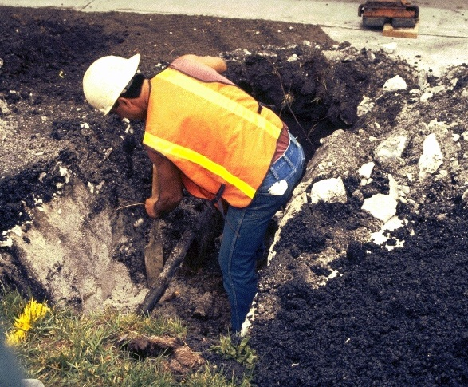
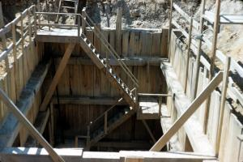
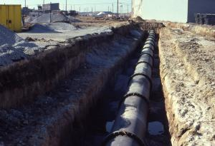
Excavations
Source of photos: NIOSH /John Rekus
Notes:
Excavation and trenching are among the most hazardous construction operations.

Slide 3
Excavations
Lesson Overview
  Role of Competent Person
  Excavation Hazards
  Protection from Cave-ins
  Protection from other Excavation Hazards
  Employer Requirements
Notes:
Enabling Objectives:
Describe the role of a competent person at an excavation site.
Identify hazards associated with excavations.
Describe the methods for protecting employees from cave-ins.
Apply excavation hazard protection methods.
Recognize employer requirements to protect workers from excavation hazards.

Slide 4
Role of Competent Person
Required training and knowledge
  Soil classification
  Use of protective systems
  OSHA’s requirements for excavation
Able to identify hazards and have the authority to eliminate hazards
Notes:
What a competent person needs to know…
OSHA defines soil types: Stable Rock, Type A, Type B and Type C [see 1926 Subpart P Appendix A (b)].
Competent persons must be able to determine soil type based on at least one visual and one manual test performed at the job-site.
OSHA standards require that employers inspect trenches daily and as conditions change by a competent person before worker entry to ensure elimination of excavation hazards. A competent person is an individual who is capable of identifying
existing and predictable hazards or working conditions that are hazardous, unsanitary, or dangerous to workers, soil types and protective systems required, and who is authorized to take prompt corrective measures to eliminate these hazards and conditions.

Slide 5
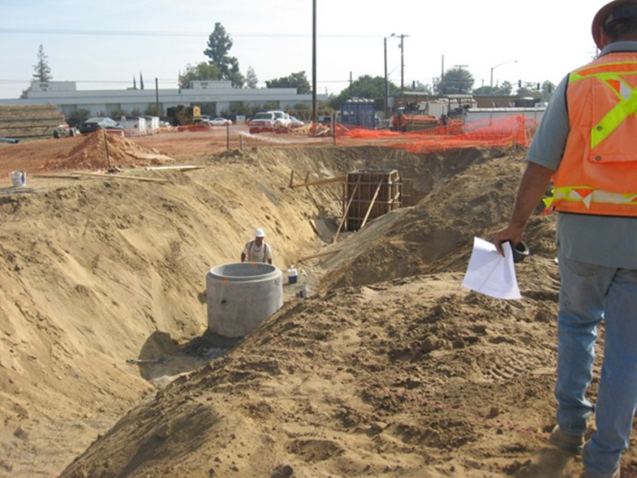
This competent person is inspecting the excavation, surroundings and protective system. If a hazard is identified, they will remove the worker and take prompt corrective action.
Source of photo: OTIEC Chabot Las Positas
Notes:
Inspections must be made:
Before work begins.
After rainstorms, high winds, or other occurrences that may increase hazards.
When it can reasonably anticipated that a worker will be exposed to hazard(s).
It is the responsibility of the competent person to make those inspections necessary to identify situations that could result in hazardous conditions (e.g., possible cave-ins, indications of failure of protective systems, hazardous atmospheres, or other hazardous conditions), and then to insure that corrective measures are taken. It is, therefore, subject to the conditions present at each individual worksite whether or not a competent person is required to be present at the jobsite at all times.
Note: Identify hazards – soil type – sloping – materials at edge of excavation

Slide 6
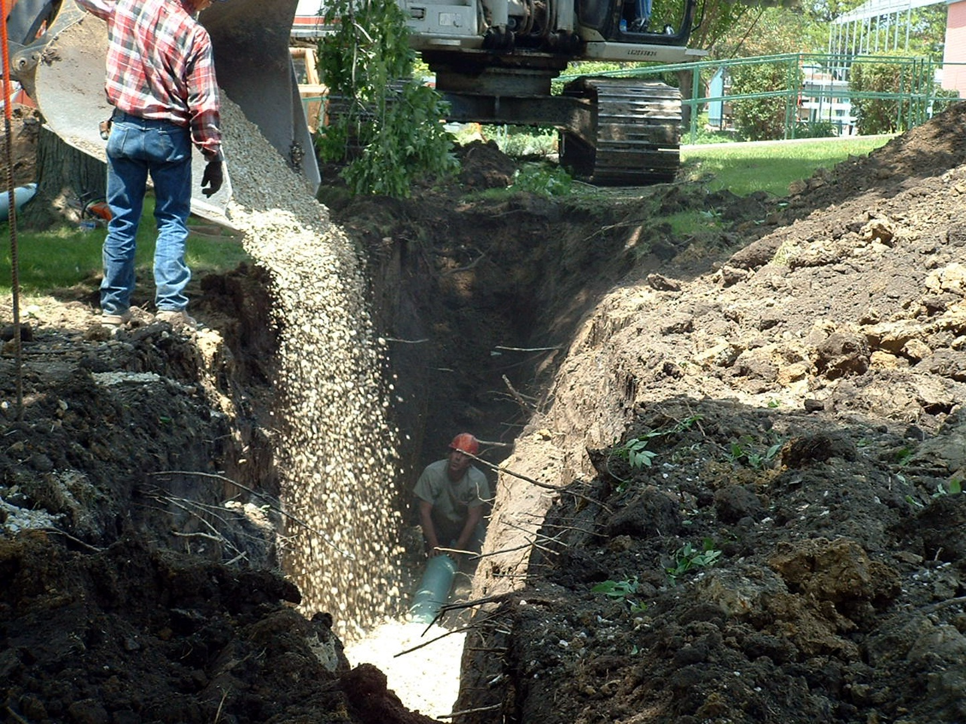
Excavation Hazards
This is a very dangerous situation!
Cave-ins
Falls
Falling Loads
Hazardous Environment
Mobile Equipment
Underground Utilities
Source of photo: OSHA
Notes:
Ask the class how many of these exist in this photo?
Have the students brainstorm on what environmental hazards might be.
Ask the students which they feel is the greatest hazard?

Slide 7
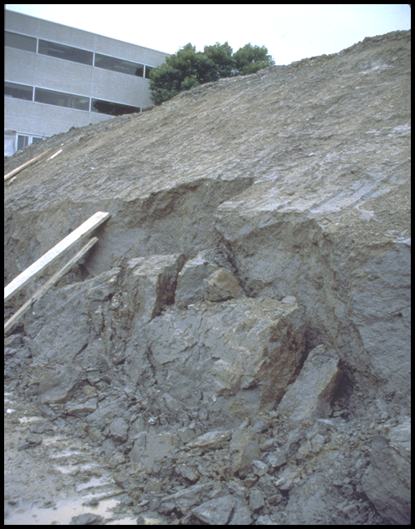

Cave-Ins
Greatest hazard
It is natural for a trench to try to fill itself
One cubic foot of soil weighs between 90-130 lbs.
It will entrap, bury, or otherwise injure you
Notes:
Cave-ins pose the greatest risk and are much more likely than other excavation related accidents to result in worker fatalities.
Two workers die every month in trench collapses!

Slide 8
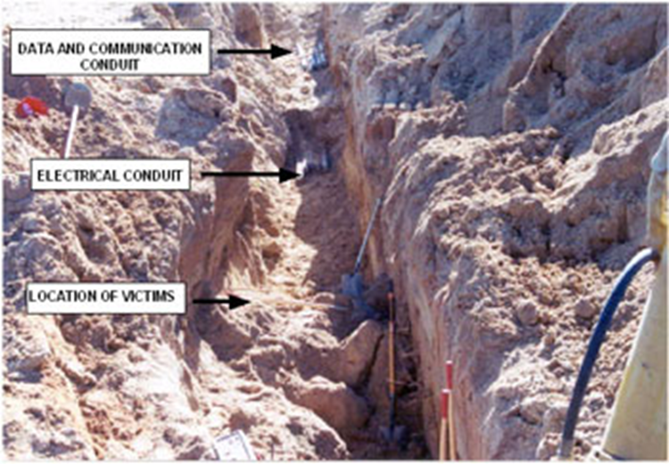
They Both Died
A crew was installing conduit in an 8’ deep by 2’ wide trench.
The trench collapsed.
Two workers were buried.
They both died!
Source of photo: CDC/NIOSH/FACE

Slide 9
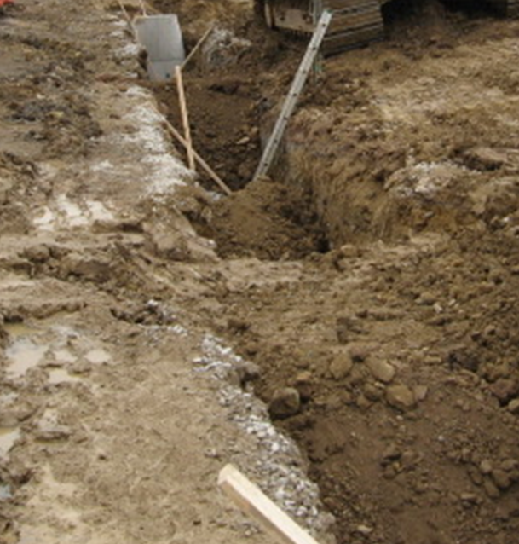
Protection is Required
Never enter an unprotected trench that is 5 or more in depth
The competent person must first choose and implement a protective system
Even excavations less than 5 feet deep need to be deemed safe by the competent person
Cave-ins can happen without warning
This 6 foot deep vertical-sided, unprotected trench is dangerous!
Source of photo: OTIEC NRC WVU

Slide 10
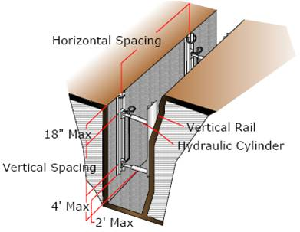
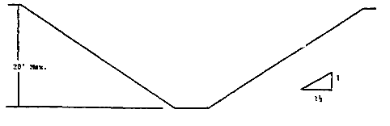
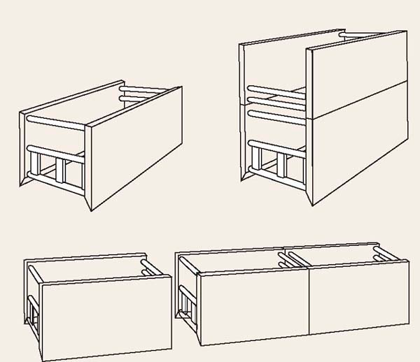
Protective Systems
Support/shoring systems
Sloping and benching
Shielding systems (trench boxes)
Shoring
Sloping
Shielding
Notes:
How does the competent person choose the most appropriate protective system design?
Designing a protective system can be complex because they must consider many factors: soil classification, depth of cut, water content of soil, changes due to weather and climate, or other operations in the vicinity. Employers are free to choose the most practical design approach for any particular circumstance. Once they have selected an approach, however, the system must meet the required performance criteria.
Protective systems are not require when an excavation is made entirely in stable rock or is less than 5 feet (1.52 meters) deep, if a competent person has examined the ground and found no indication of a potential cave-in.

Slide 11
Support/shoring Systems
Source of photos: NIOSH /John Rekus
Notes:
Shoring (Shoring system) means a structure such as a metal hydraulic, mechanical or timber shoring system that supports the sides of an excavation and which is designed to prevent cave-ins.

Slide 12
The Theory of Shoring
Shoring prevents cave-ins
Shoring, if designed and installed correctly, prevents movement of the excavated wall.
In order for the shoring to do its job, you must stay within the protection of the shoring even when entering and exiting

Slide 13
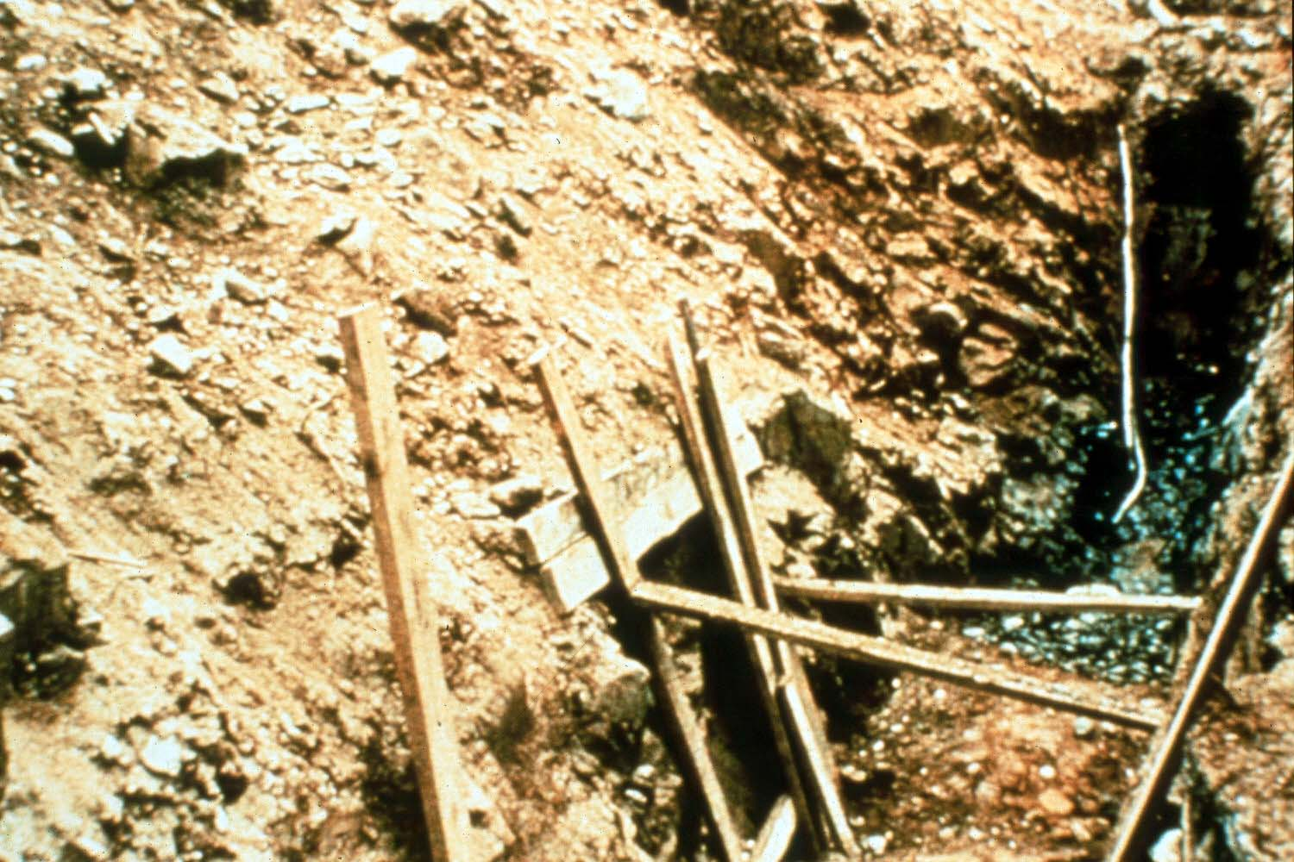
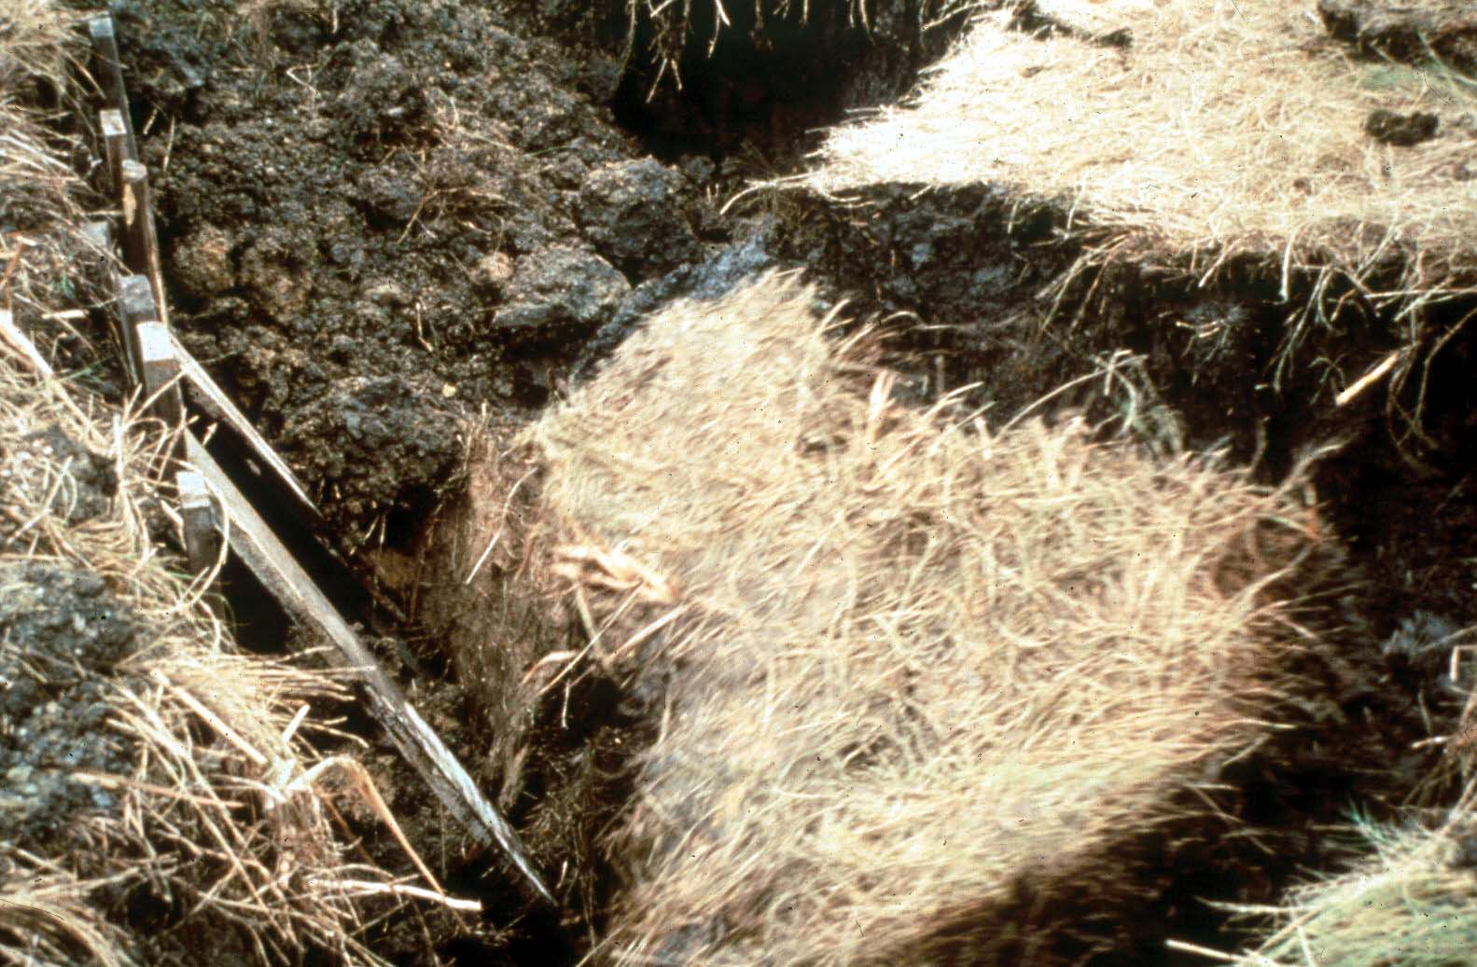
Improper Shoring
Make-shift, improperly designed shoring does little other then provide a false sense of security!
Source of photos: OSHA

Slide 14
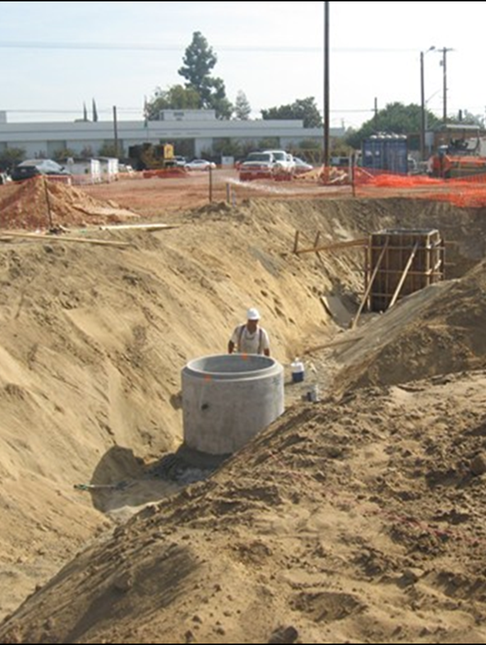
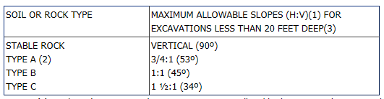
Sloping and Benching
This slope is safe for any soil classification!
Is this a 1 ½ to 1 slope?
Notes:
Some contractors may choose to slope the sides to an angle not steeper than 1-1/2:1; for example, for every foot of depth, the trench must be excavated back 1-1/2 feet. A slope of this gradation or less is safe for any type of soil.
Sloping at steeper angles will require the competent person to first classify the soil and then chose a slope which will protect you from cave-ins.
The photo above is actually depicting Type C soil and is not sloped properly.

Slide 15
The Theory of Sloping
Sloping prevents cave-ins
Sloping, if done correctly, removes the risk of cave-ins by sloping the soil of the trench back from the trench bottom
Source of photo: OTIEC NRC WVU

Slide 16
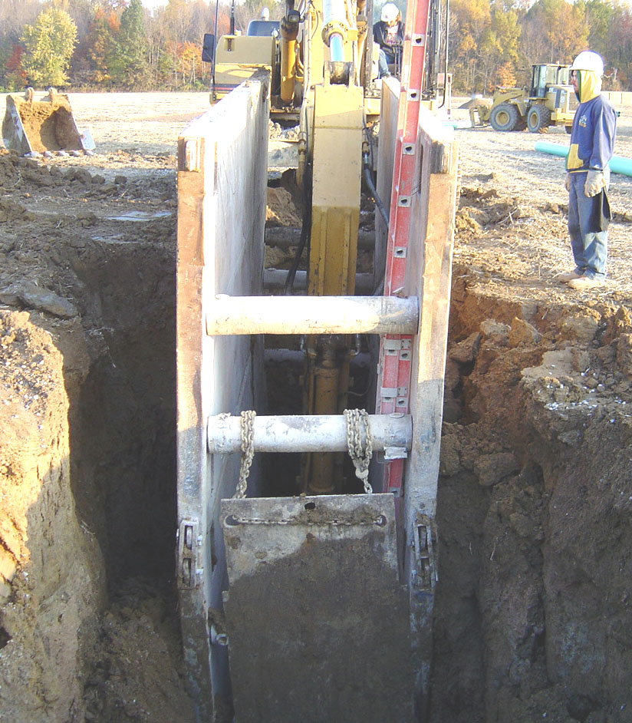
Shield System
How many hazards can you find ?
Source of photo: OSHA
Notes:
Shield (Shield system) means a structure that is able to withstand the forces imposed on it by a cave-in and thereby protect employees within the structure. Shields can be permanent structures or can be designed to be portable and moved along as work progresses.
Trench shields and boxes, if installed correctly, are designed to protect workers from the forces of a cave-in
In order for the shield to do its job, the worker must stay within the protection of the shield even when entering and exiting
Use a trench box or shield designed or approved by a registered professional engineer or based on tabulated data prepared or approved by a registered professional engineer.
Timber, aluminum, or other suitable materials may also be used.
Photo hazards: Improper use of ladder, trench plate can not be hung from strut, box is not stabilized, fall hazard trying to get in and out of box.

Slide 17
The Theory of Shielding
Trench shields and boxes, if installed correctly, are designed to protect workers from the forces of a cave-in
In order for the shield to do its job, you must stay within the protection of the shield even when entering and exiting

Slide 18
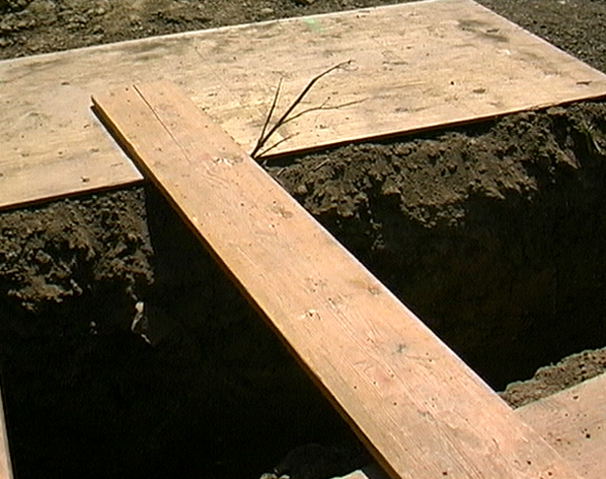
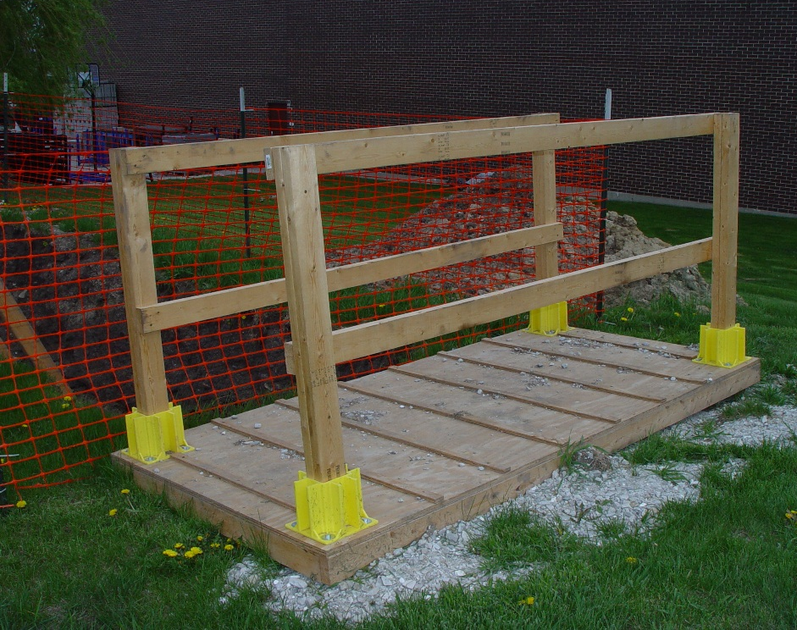
Falls
Safe Alternative
Source of photos: OSHA
Notes:
Class discussion
Ask the class if they have ever seen anything like the photo on the left?
Next ask them if they have ever had to cross a trench this way?
Have them come up with a conclusion of the worst possible scenario should they fall.
Explain why the photo on the right represents a safer solution.

Slide 19
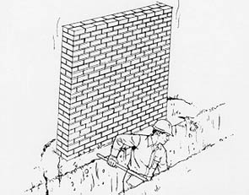
Adjacent Structures
Structures become unstable when earth next to them is removed
For your safety, they must be supported
A competent person must ensure precautions are implemented.
Notes:
Excavations under sidewalks and pavements are prohibited unless you provide an appropriately designed support system or another effective means of support.

Slide 20

Underground Utilities
As required, this worker’s employer used their state’s one call system to locate under ground utilities before breaking ground. Now he is hand digging to find the exact location.
Source of photo: OSHA
Notes:
Before starting work, the OSHA standard requires your employer to do the following:
Determine the approximate location of utility installations—sewer, telephone, fuel, electric, and water lines; or any other underground installations;
Contact the utility companies or owners involved to inform them of the proposed work within established or customary local response times; and
Ask the utility companies or owners to find the exact location of underground installations. If they cannot respond within 24 hours (unless the period required by state or local law is longer) or cannot find the exact location of the utility installations, you may proceed with caution.
When finding the exact location of underground utilities, proceed with caution, by hand or other acceptable safe means.
Potholing is a practice used to determine the location of underground utilities by digging test holes to expose such a facility.
1926.651(b)(3) When excavation operations approach the estimated location of underground installations, the exact location of the installations shall be determined by safe and acceptable means.
The use of heavy equipment, such as a backhoe, for potholing is not a preferred method due to the riskiness of this endeavor compared to other methods of potholing. http://www.marc.org/Government/Local-Government-Services/pdf/Potholing

Slide 21

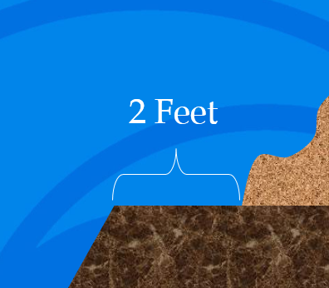
Spoil Pile
Minimum
Source of photo: OSHA
Notes:
You must be protected from excavated or other materials or equipment that could pose a hazard by falling or rolling into excavations.
Protection shall be provided by placing and keeping such materials or equipment at least 2 feet (.61 m) from the edge of excavations, or by the use of retaining devices that are sufficient to prevent materials or equipment from falling or rolling into excavations, or by a combination of both if necessary.
Possibly could be further back due to “surcharge load”

Slide 22
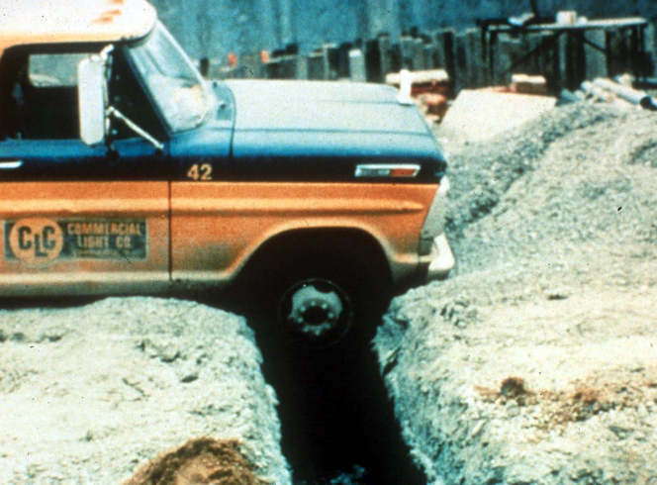
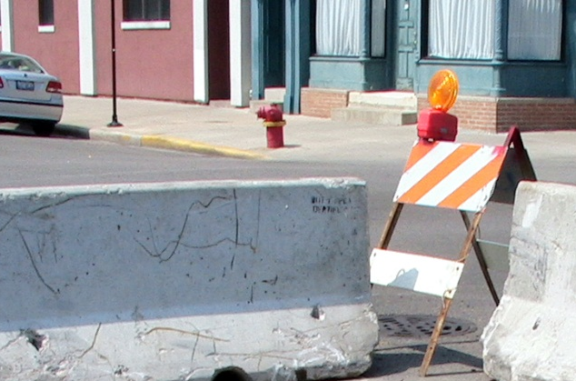
Mobile Equipment
Safe Alternative
Source of photos: OSHA
Notes:
When mobile equipment is operated adjacent to an excavation; the operator must have a clear and direct view of the edge of the excavation, or… A warning system shall be utilized such as barricades, hand or mechanical signals, or stop logs. If possible, the grade should be away from the excavation.

Slide 23
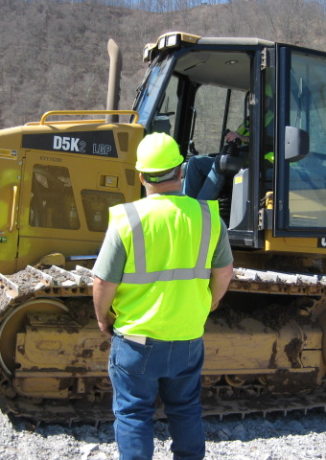
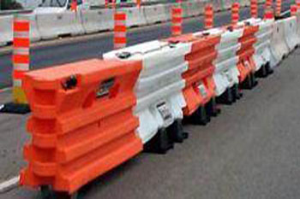

Vehicular or Traffic Hazards
Source of photos: OSHA
Notes:
Excavations which expose workers to vehicular traffic require specific precautions and controls.
Employees exposed to public vehicular traffic shall be provided with, and shall wear, warning vests or other suitable garments marked with or made of reflectorized or high-visibility material.
All traffic control signs or devices used for protection of construction workers shall conform to Part VI of the MUTCD, 1988 Edition, Revision 3, or Part VI of the MUTCD, Millennium Edition.

Slide 24
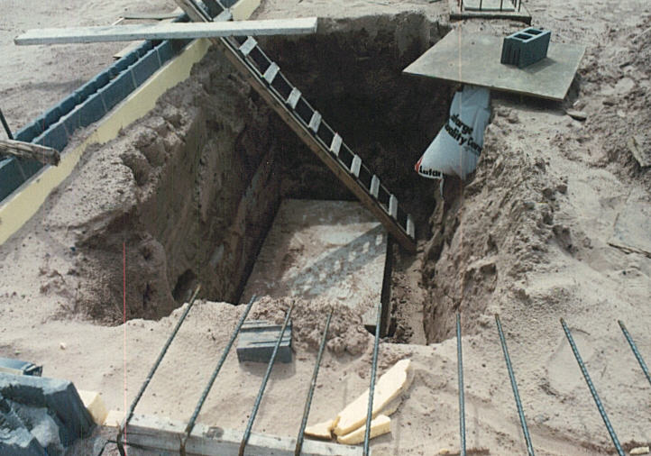
Falling Loads
Do you see any other hazards?
Source of photo: OSHA
Notes:
Materials too close to the excavation.
Other Photo hazards: Improperly constructed ladder; improper protection of type C soil.

Slide 25
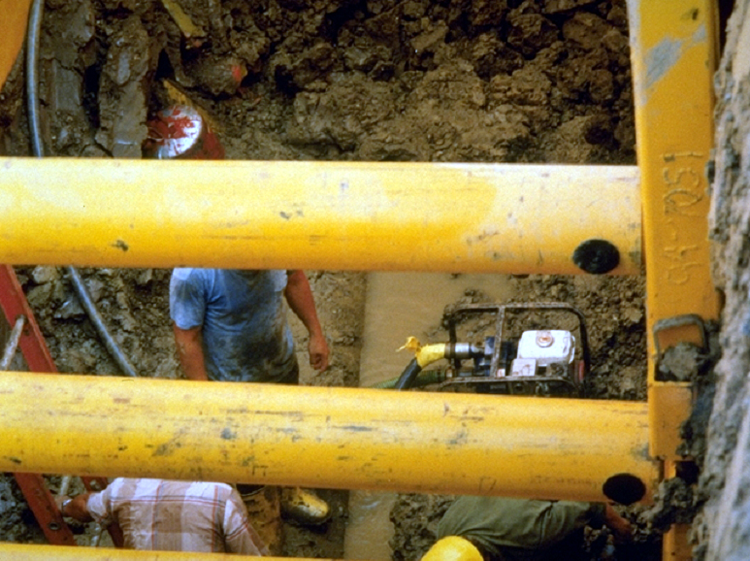
Hazardous Atmospheres
Source of photo: OSHA
Notes:
Ask the class what the potential atmospheric hazards are depicted here?
A competent person must test any excavation deeper than 4 feet (1.22 meters) or where an oxygen deficiency or a hazardous atmosphere is present or could reasonably be expected, such as a landfill or where hazardous substances are stored nearby, before an employee enters it. If there are any hazardous conditions, your employer must provide the controls such as proper respiratory protection or ventilation.
In addition, employers are responsible for regularly testing all controls used to reduce atmospheric contaminants to acceptable levels.
If unhealthful atmospheric conditions exist or develop in an excavation, they must provide emergency rescue equipment such as a breathing apparatus, safety harness and line, and basket stretcher and ensure that it is readily available. This equipment must be attended when in use.

Slide 26
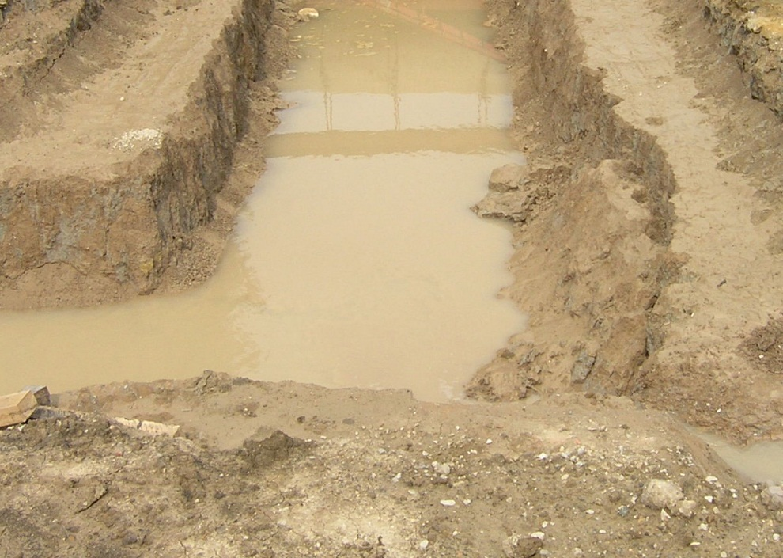
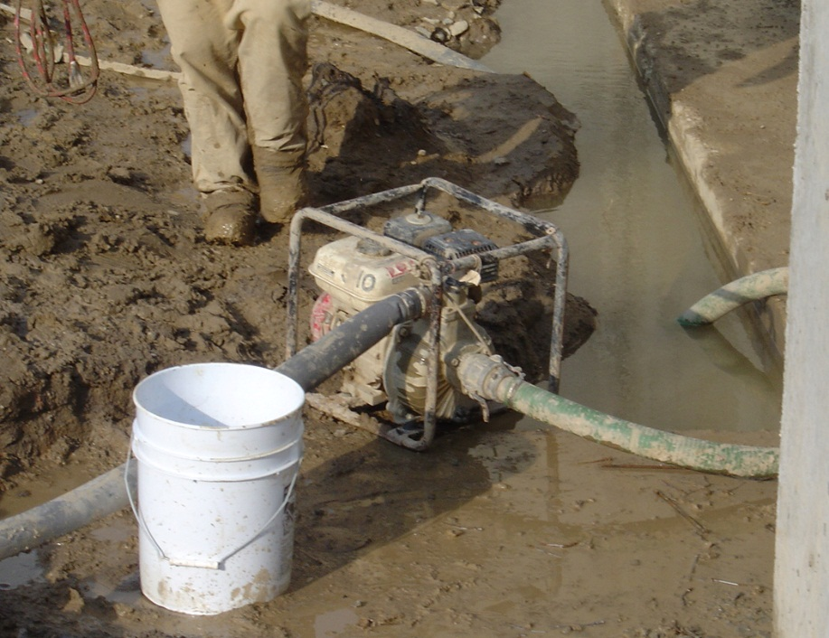
Water Accumulation
Source of photos: OSHA
Notes:
Water changes everything and makes soil less stable.
Efforts must be make to keep water out of excavations.
Among the additional hazards stemming from water in an excavation are undermining the sides and making it more difficult to get out of the excavation. You must have adequate protection in excavations where water has accumulated or is accumulating.
If your employer uses water removal equipment to control or prevent water accumulation, you must ensure that a competent person monitors the equipment and its operation to ensure proper use.
Diversion ditches, dikes, or other suitable means can also be used to prevent surface water from entering an excavation and to provide adequate drainage of the adjacent area.
In addition, a competent person must inspect excavations subject to runoffs from heavy rains.

Slide 27
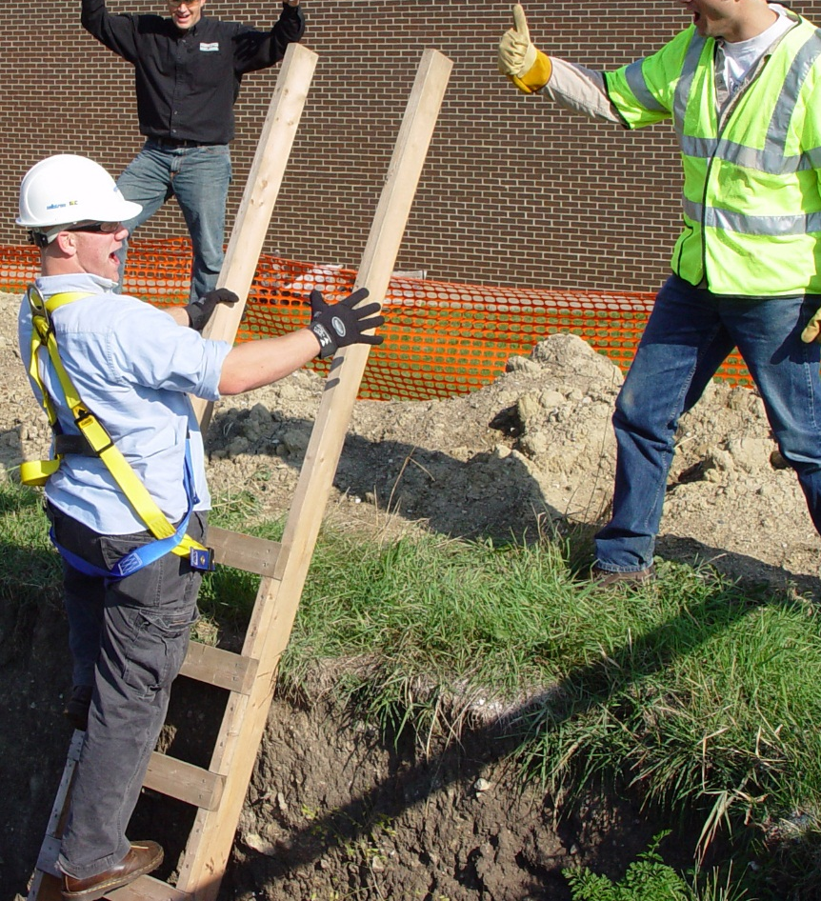
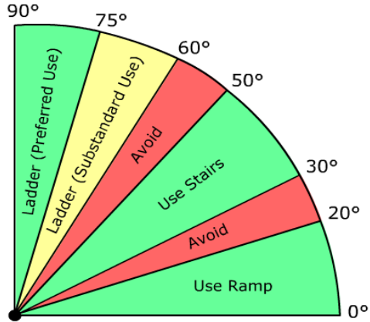
Access/Egress
Source of photo: OSHA
Notes:
You must have safe access and egress when working in excavations, including ladders, steps, ramps, or other safe means of exit for employees working in trench excavations 4 feet (1.22 meters) or deeper.
These devices must be located in the excavation within 25 feet (7.62 meters) of all workers.
Any structural ramps must be designed by a competent person if they are used for employee access or egress, or by a competent person qualified in structural design if they are used for vehicles. Also, structural members used for ramps or runways must be uniform in thickness and joined in a manner to prevent tripping or displacement.

Slide 28
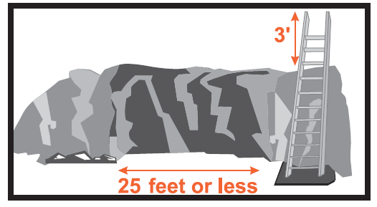
Ladders

Slide 29
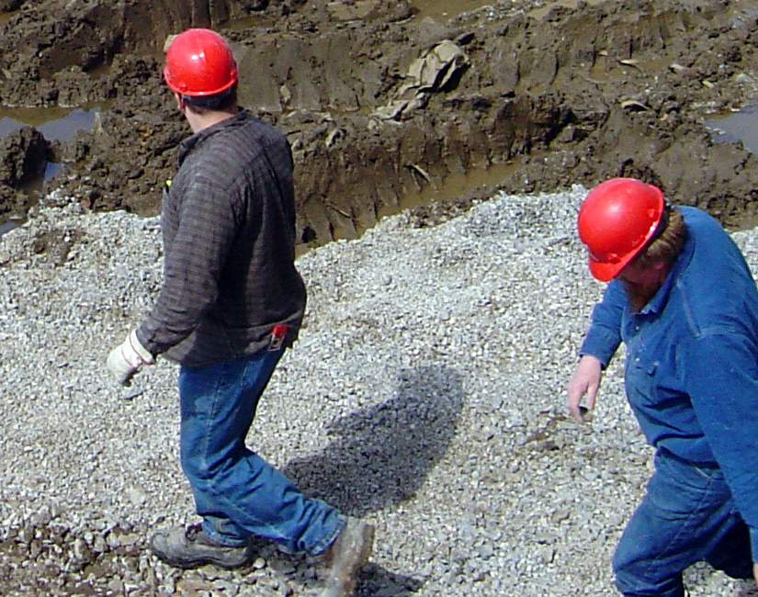
Hard Hats
Working below grade, overhead hazards exist
Hard hats must be worn in excavations because of overhead hazards
Source of photo: OSHA

Slide 30
Responsibilities: Employer
Employers must:
  preplan the work and use the one-call system to identify underground utilities
  protect you from cave-ins and other excavation-related hazards
  inspect the excavation at least daily and throughout the shift as needed
  take prompt corrective action when a hazard is identified
  respond to and correct hazards pointed out by you, the worker

Slide 31
Responsibilities: Employer
Employers must:
  make sure a ladder is within 25’ of your work area when deeper than 4’
  keep excavated dirt, rocks and other materials back 2’ from the excavation’s edge
  Test and monitor the air within the trench in areas suspect to atmospheric hazards

Slide 32
Responsibilities: You
You must:
  work defensively
  Follow you company’s excavation and trenching safety rules
  correct the hazards you are able to correct
  report to your supervisor the hazards you are unable to correct

Slide 33
Case Study
Notes:
The victims were members of a crew installing conduit in an eight-foot-deep by two-foot-wide trench. After approximately an hour, the crew leader grounded the bucket, turned the machine off and walked to the company trailer to check blueprints. As he exited the trailer, he was informed by one of the workers that the trench had collapsed and that the two employees had been covered up.
Ask the class for 3-4 things that may have contributed to these workers losing their lives.
Possible Answers: Improper safety oversight. No protective system. No way to get out. Spoil pile too close. Any others?
Ask the class for 3-4 recommendations for preventing a similar incident.
Possible Answers: Have a competent person. Evaluate the soil and implement a protective system. Have a ladder for egress. Educate workers. Any others?

Slide 34
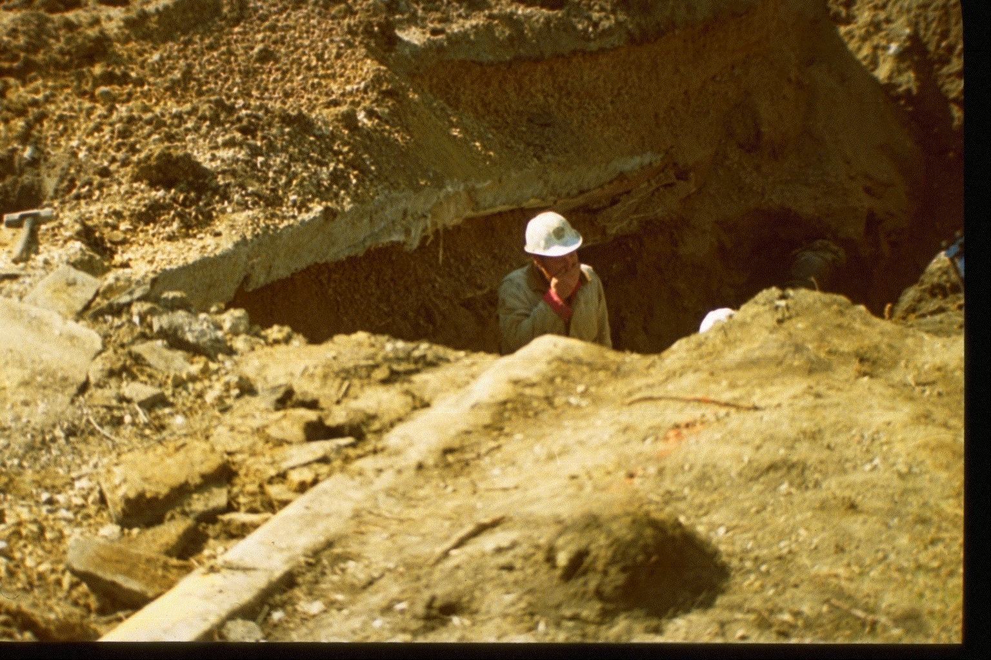
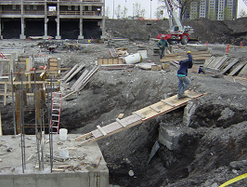
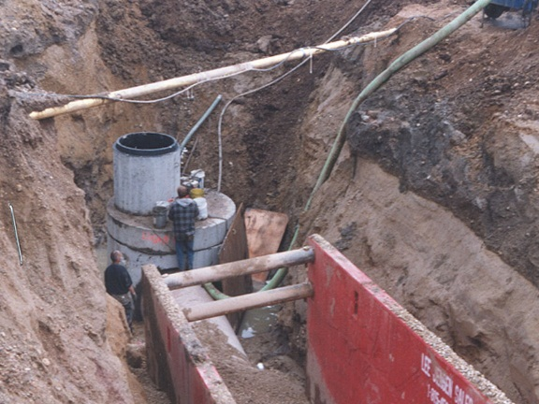
Hazard Recognition
Identify hazards and what should be done
Source of photos: OSHA
Notes:
Photo left: Unprotected trench, undermined-unsupported pavement, spoil pile too close.
Photo middle: Workers leaving protection of trench box. Inadequate box – open ends – need stackable box or lay sloping angle back. Unsupported utilities
Right photo: Fall hazard. Improperly constructed walkway – proper access egress needed
Have students propose solution for each.

Slide 35
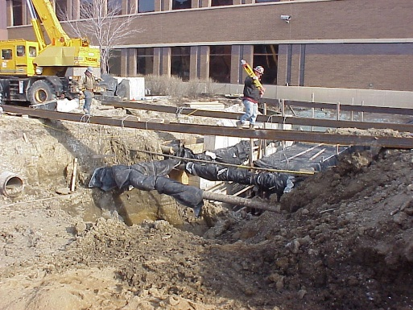
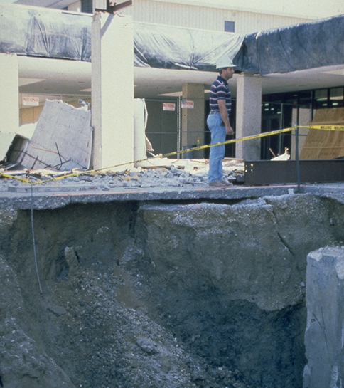
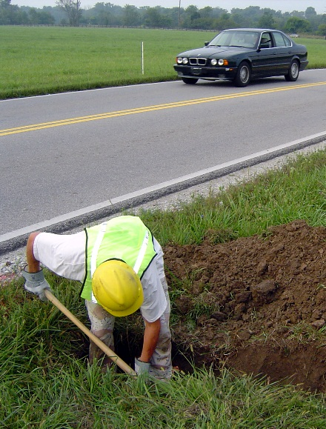
Hazard Recognition
Identify hazards and what should be done
Source of photos: OSHA
Notes:
Photo left: Fall hazard. Proper support? Engineering? Surcharge load of crane.
Photo middle: Work zone hazard, traffic with no barricades. Class of Vest?
Photo right: Fall hazard, undermined pavement, unprotected excavation. Engineering of all surface encumbrances.
Have students propose solutions for each.

Slide 36
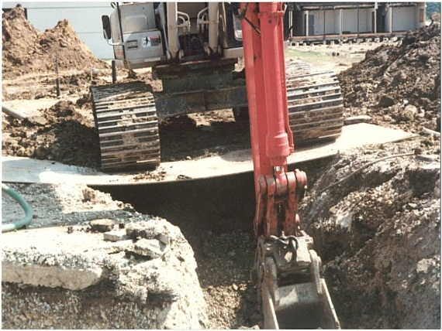
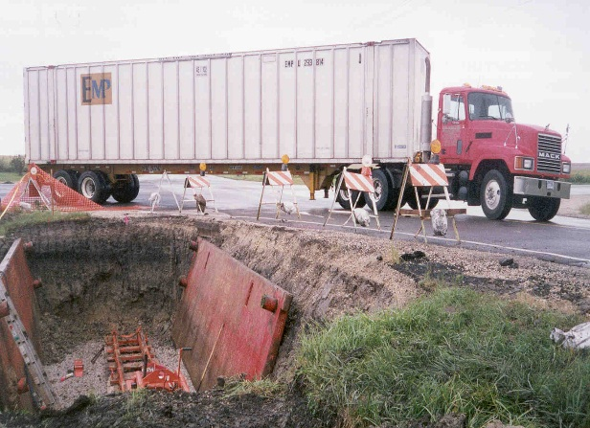
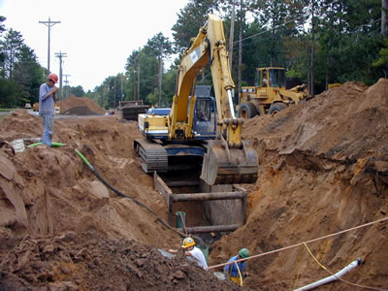
Hazard Recognition
Identify hazards and what should be done
Source of photo: OSHA
Notes:
Photo left: Unsafe loads being place on soil. Surcharge loads. Spoil piles.
Photo middle: Workers leaving protective system, unsupported utility pipe. Inadequate protection – sloping.
Photo right: Improperly installed protective system and potential worker exposure to traffic. Surcharge load.
Have students propose solutions

Slide 37
Always Remember
Never enter a trench 5’ or greater in depth unless a protective system is in place.
Trenches less than 5’ deep still require the competent person’s “OK”
If a trench box or shoring is used, never leave its protection while in the trench

Slide 38
Knowledge Check
What is the minimum distance that excavated materials, tools, and other supplies be kept back from the excavation’s edge?
  1 foot
  2 feet
  7.5 feet
  25 feet
  b. 2 feet

Slide 39
Knowledge Check
At what depth must a ladder, ramp, steps, or runway be present for quick worker exit:
  4 feet
  5 feet
  10 feet
  It is never required
  a. 4 feet

Slide 40
Knowledge Check
What is the greatest hazard facing a worker while working in a trench:
  Hazardous atmospheres
  Falls
  Cave-ins
  Falling Objects
  c. Cave-ins

Slide 41
Knowledge Check
Unless made in entirely stable rock, at what depth is a protective system required for a trench:
  Any depth if the competent person says so.
  5 feet deep and greater
  Both a and b
  A protective system is never required in trenches
  c. Both a and b

Slide 42
Excavations in Construction
Questions?

