Slide 1
Cranes
10-Hour Construction Outreach

Slide 2
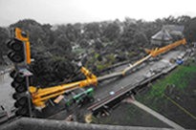
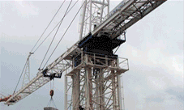
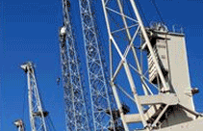
Cranes
Source of photos: OSHA
Notes:
1926 Subpart CC – Cranes and Derricks in Construction
Other standards and references used for this presentation are as follows:
Mobile Hydraulic Crane Standards
- PCSA Standard NO. 2
- Power Crane and Shovel Association
2. USA Standards
- Safety Code for Cranes, Derricks, Hoists, Jacks and Slings
- Crawler, locomotive and truck cranes
- USAS B30.5-1968

Slide 3
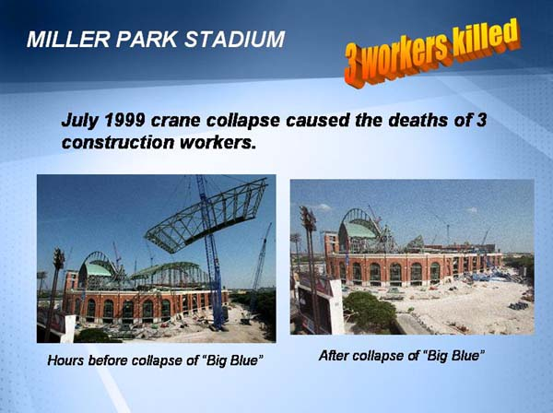
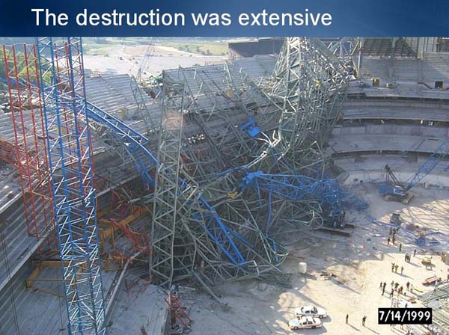
Cranes
Discuss “Big Blue” crane collapse
Case Study
https://www.osha.gov/dcsp/success_stories/compliance_assistance/abbott/abbott_casestudies/slide30.html
Notes:
Miller Park Stadium - July 1999 crane collapse caused the deaths of 3 construction workers.
Source: OSHA.gov

Slide 4
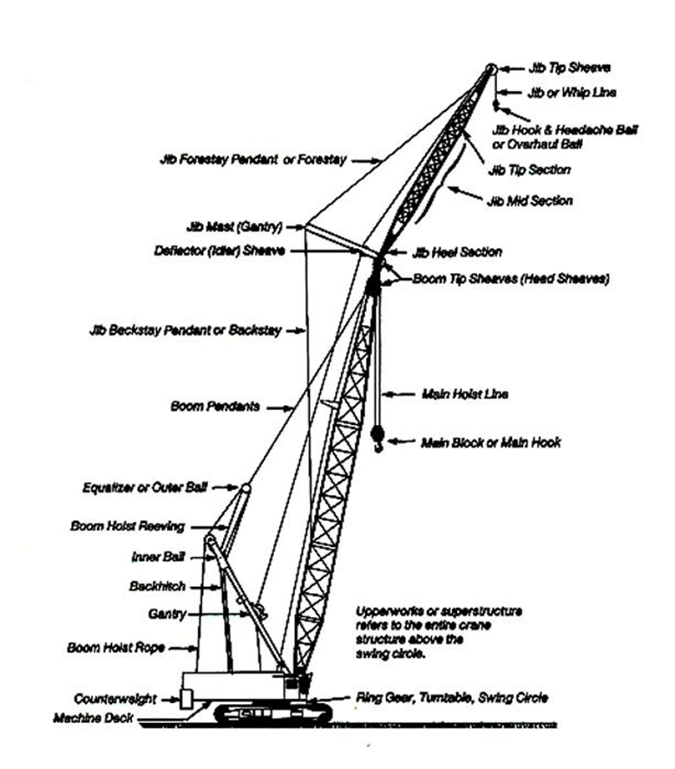
Cranes
Source: OSHA

Slide 5
Cranes
Lesson Overview
  Common Causes of Crane Accidents
  Crane Use
  Crane Use Near Power Lines
  Employer Requirements
  Training Requirements
Notes:
Moving large, heavy loads is crucial to today's construction industry. Much technology has been developed for these operations, including careful training and extensive workplace precautions. There are significant safety issues to be considered, both for the operators of the diverse "lifting" devices, and for workers in proximity to them. (Source: OSHA.gov)
Enabling Objectives:
Identify common causes of crane accidents.
Describe requirements for crane use, including pre-planning methods.
Describe precautions for crane use near power lines.
Recognize employer requirements to protect workers from crane hazards.
Explain training requirements related to crane operations.

Slide 6
  Common Causes of Crane Accidents
Four Major Types of Crane Accidents
  Contact with power lines
  Overturns
  Mechanical Failures
  Falls
Notes:
Four Major Types of Crane Accidents
Contact with power lines is a leading cause of crane accidents.
Must be aware of placement of power lines surrounding worksite
Maintain clearance of at least 20 feet from energized electrical lines unless other precautions have been implemented
Shut off active power lines to prevent electrocution from accidental contact with live wires
Overturns - causes
Overloads
Loss of center of gravity control
Outrigger failure
High winds
Side pull
Improper maintenance
Mechanical Failures – Routine maintenance should be followed to prevent accidents due to mechanical failure. Components with excessive wear should be repaired and replaced as soon as possible.
Falls – causes
Missing hand rails
Improper crane operation
Improper maintenance
5. Other causes of crane accidents include:
Under the hook lifting device,
Dropped loads,
Boom collapse,
Crushing by the counter weight,
Outrigger use
Rigging failures
Source: OSHA.gov

Slide 7
  Common Causes of Crane Accidents
  Reasons accidents occur:
  Poor Load Planning/Instability
  Lack of communication
  Lack of training
  Inadequate maintenance or inspection of equipment
Notes:
Reasons Accidents Occur
Poor planning. Not knowing the weight of the load or the characteristics of the crane. Instability of crane, instability of load, or poor ground conditions (not level or too soft) can contribute to crane accidents.
Lack of communication between the crane operator and ground personnel.
Lack of training. Operators who do not have proper training in crane operation and safety procedures may lead to crane accidents. Everyone involved in maintaining, repairing, and assembling the crane should have training.
Inadequate maintenance or inspection of equipment. Timely, consistent inspections by experienced and well-trained inspectors can prevent accidents. As mentioned previous, routine maintenance should be followed and components with excessive wear should be repaired and replaced as soon as possible.

Slide 8
  Hazardous Environments for Crane Operations
  Improper loading rating
  Excessive speeds
  No hand signals
  Inadequate inspection and maintenance
  Unguarded parts
  Unguarded swinging radius
  Working too close to power lines
  Improper exhaust systems
  Shattered windows
  No steps or guardrails on walkways
  No boom angle indicator
  Not using outriggers
Notes:
Conditions and actions that create hazardous environments for crane operations.
Improper loading rating. Solution: Check to ensure the load does not exceed the crane’s rated capacity.
Excessive speeds. Solution: Maintain safe speed of operation in accordance with manufacturer’s recommendations.
No hand signals. Solution: Ensure the signal person meets OSHA’s qualifications.
Inadequate inspections and maintenance. Solution: Check all crane equipment and controls to insure proper operation is possible before use. Plan and preform routine inspections and maintenance.
Unguarded parts. Solution: Ensure that all required guards are securely in place.
Unguarded swinging radius. Solution: Barricade accessible areas within the crane’s swing radius.
Working too close to power lines. Solution: Watch for overhead power lines and maintain safe working clearance of at least 20 feet from energized electrical lines.
Improper exhaust systems. Solution: Ensure equipment exhaust is properly maintained and is in proper working condition.
Shattered windows. Solution: Replace damaged windows to ensure proper visibility.
No steps or guardrails on walkways. Solution: Ensure that all walkways are equipped with standard railings.
No boom angle indicator. Solution: Ensure all operational aids including boom angle indicators are working properly.
Not using outriggers. Solution: Fully extend outriggers in accordance with the lifting conditions and the load chart.

Slide 9
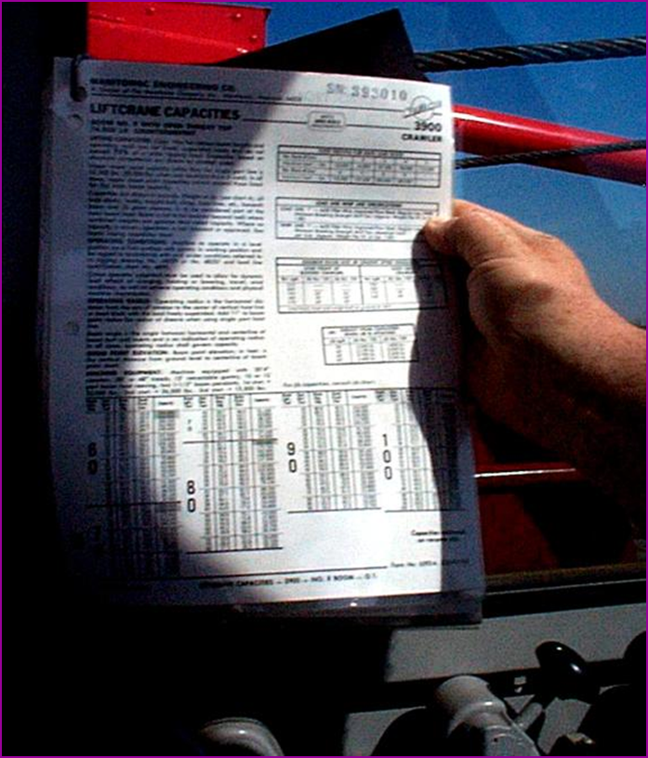
  Load Capacity – Speed - Warnings
Make sure the crane operator can see the:
  Rated Load Capacities
  Operating Speeds
  Special Hazard Warning
  Instructions
  Operator’s manual
Source: OSHA
Notes:
APPLICABLE OSHA STANDARD
1926.1417(c)(1)The procedures applicable to the operation of the equipment, including rated capacities (load charts), recommended operating speeds, special hazard warnings, instructions, and operator's manual, must be readily available in the cab at all times for use by the operator.

Slide 10
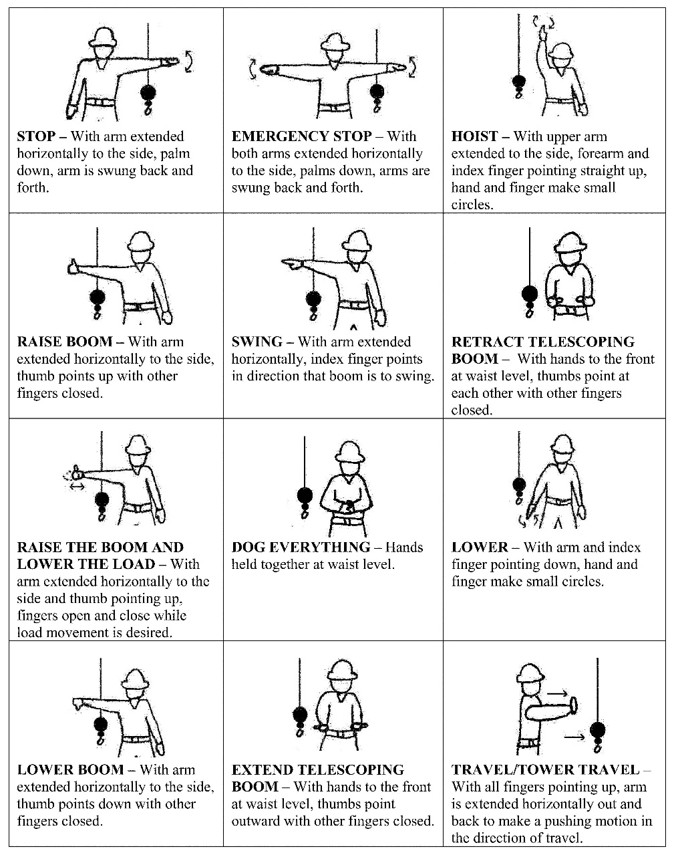
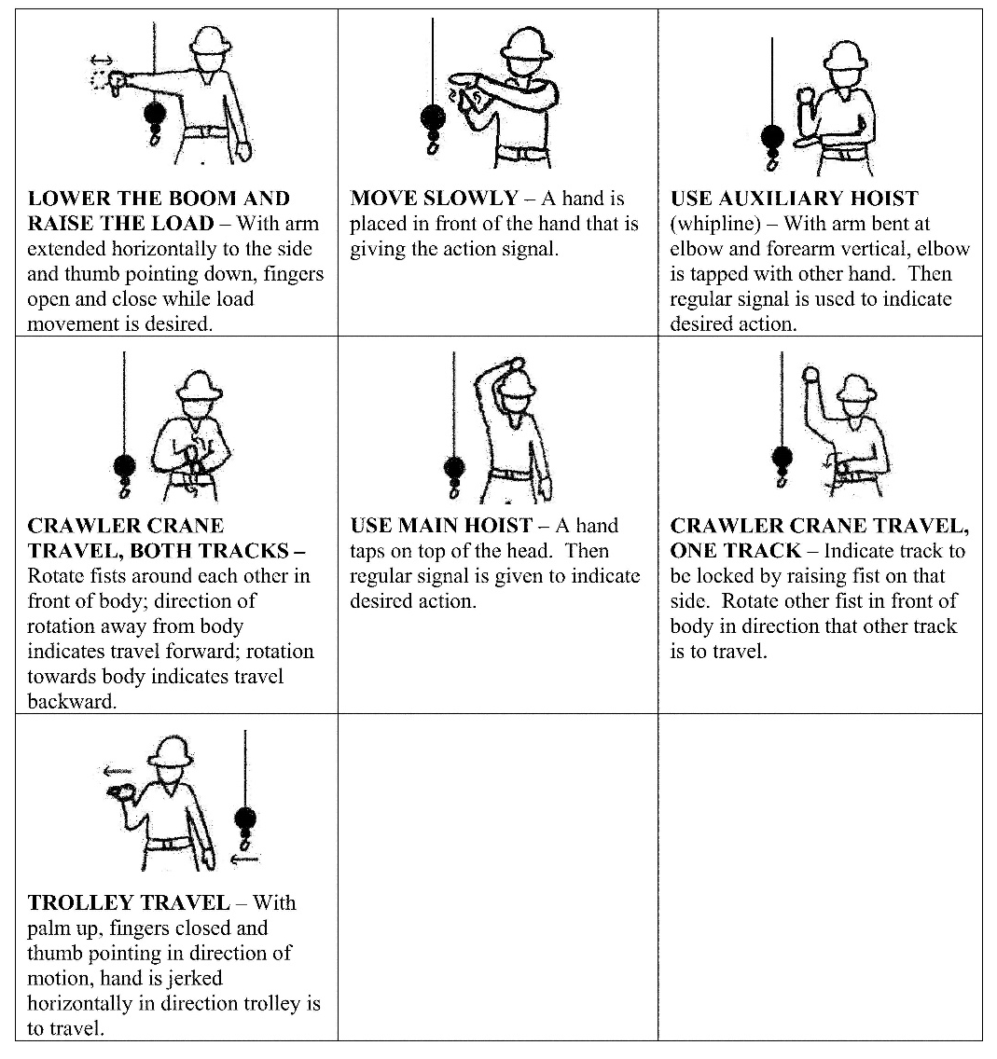
  Hand Signals
Source: Federal Register - OSHA
Notes:
An illustration of the signals must be posted on the equipment or in the vicinity of the operations.
APPLICABLE OSHA STANDARD
1926.1422 Hand signal charts must be either posted on the equipment or conspicuously posted in the vicinity of the hoisting operations.

Slide 11
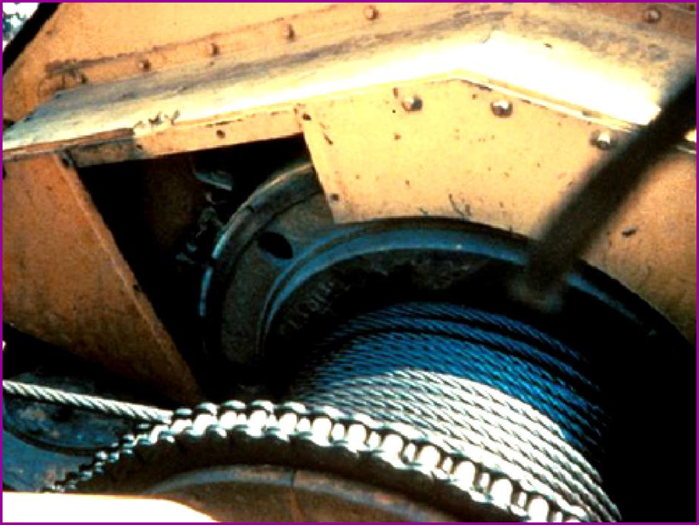
  Guard Moving Parts
Source: OSHA
Notes:
Guard moving parts such as gears or belts.
APPLICABLE OSHA STANDARD
1926.1433(d)(8)Belts, gears, shafts, pulleys, sprockets, spindles, drums, fly wheels, chains, and other parts or components that reciprocate, rotate or otherwise move must be guarded where contact by employees (except for maintenance and repair employees) is possible in the performance of normal duties.

Slide 12
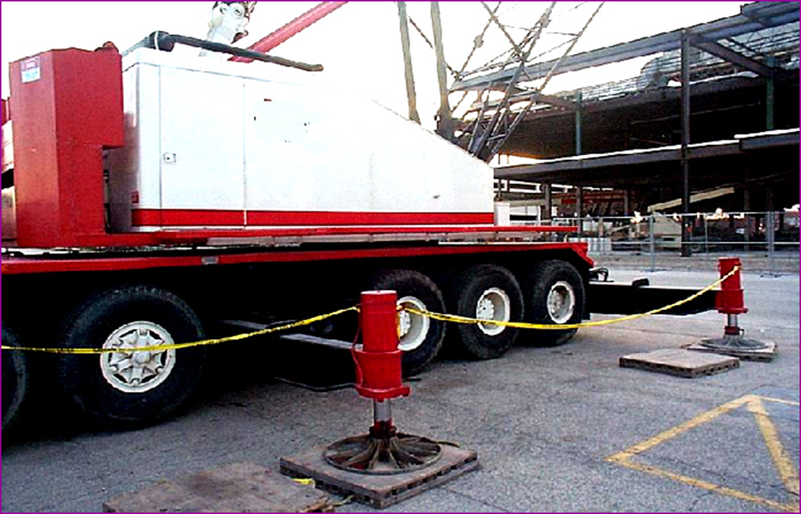
  Swing Radius
Stay out of the swing radius of the crane.
Make sure there are barrier guards showing the swing radius.
Source: OSHA
Notes:
OSHA determined that the preferred way to protect employees in these situations is to completely barricade the entire swing radius of the equipment and prevent employee access to the area.
1926.1424(a)(2)To prevent employees from entering these hazard areas, the employer must:
1926.1424(a)(2)(i)Train each employee assigned to work on or near the equipment ("authorized personnel") in how to recognize struck-by and pinch/crush hazard areas posed by the rotating superstructure.
1926.1424(a)(2)(ii)Erect and maintain control lines, warning lines, railings or similar barriers to mark the boundaries of the hazard areas. Exception: When the employer can demonstrate that it is neither feasible to erect such barriers on the ground nor on the equipment, the hazard areas must be clearly marked by a combination of warning signs (such as "Danger--Swing/Crush Zone") and high visibility markings on the equipment that identify the hazard areas. In addition, the employer must train each employee to understand what these markings signify.

Slide 13
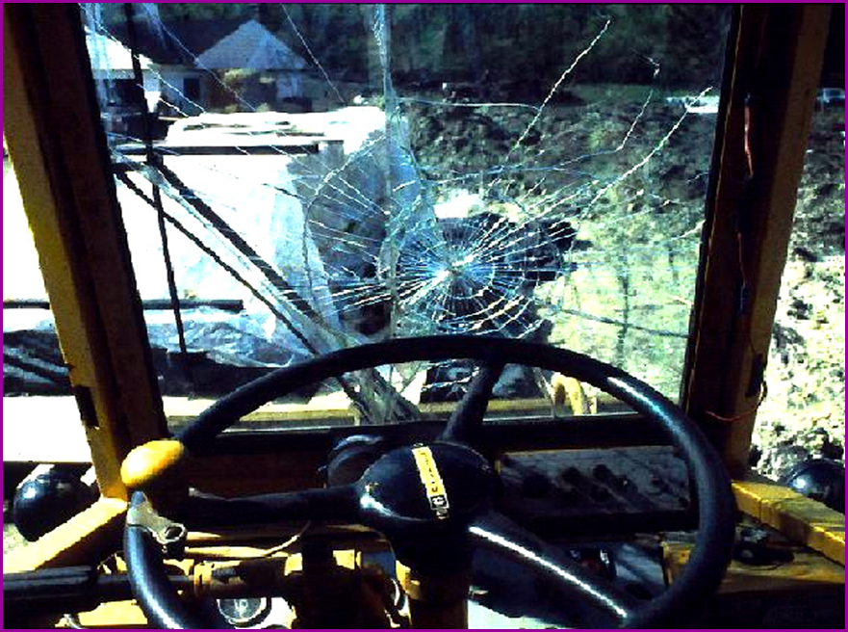
  Operator Visibility
Make sure broken windows or other obstructions do not prevent the operator from seeing.
Source: OSHA
Notes:
APPLICABLE OSHA STANDARD
1926.1433(d)(7)(iii)(C)Windows must be of safety glass or material with similar optical and safety properties, that introduce no visible distortion or otherwise obscure visibility that interferes with the safe operation of the equipment.

Slide 14
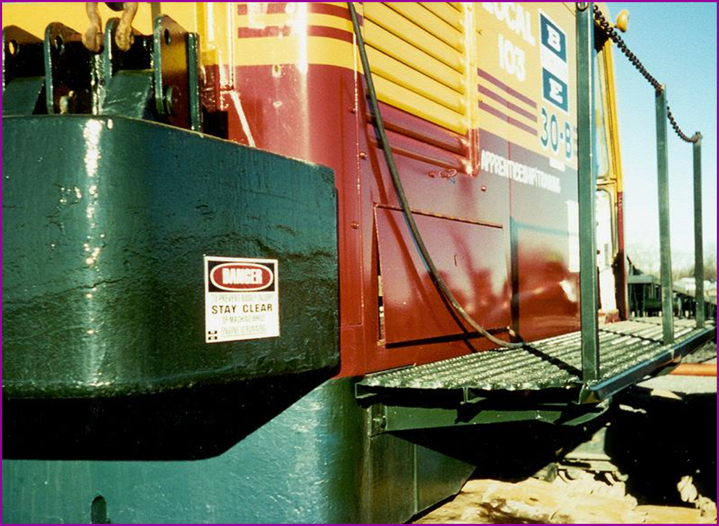
  Guardrails
Runways and steps need to have guardrails, handholds and slip resistant surfaces.
Source: OSHA
Notes:
APPLICABLE OSHA STANDARDS
1926.1423(c)(3)Equipment manufactured after November 8, 2011 must be equipped so as to provide safe access and egress between the ground and the operator work station(s), including the forward and rear positions, by the provision of devices such as steps, handholds, ladders, and guardrails/railings/grabrails. These devices must meet the following criteria:
1926.1423(c)(3)(i)Steps, handholds, ladders and guardrails/railings/grabrails must meet the criteria of SAE J185 (May 2003) (incorporated by reference, see § 1926.6) or ISO 11660-2:1994(E) (incorporated by reference, see § 1926.6) except where infeasible.
1926.1423(c)(3)(ii)Walking/stepping surfaces, except for crawler treads, must have slip-resistant features/properties (such as diamond plate metal, strategically placed grip tape, expanded metal, or slip-resistant paint).

Slide 15
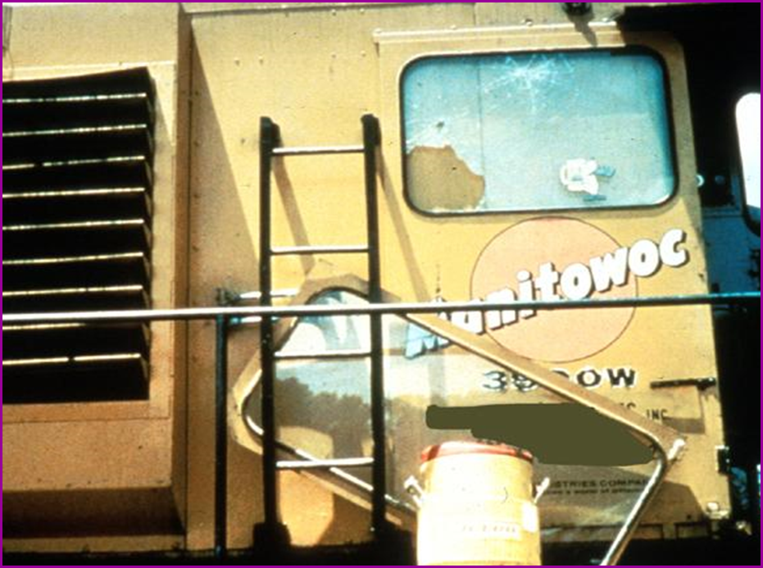
  Guardrails
Use ladders to get to the upper portion of the cab.
Source: OSHA
Notes:
APPLICABLE OSHA STANDARD
1926.1423(c)(3)Equipment manufactured after November 8, 2011 must be equipped so as to provide safe access and egress between the ground and the operator work station(s), including the forward and rear positions, by the provision of devices such as steps, handholds, ladders, and guardrails/railings/grabrails. These devices must meet the following criteria:
1926.1423(c)(3)(i)Steps, handholds, ladders and guardrails/railings/grabrails must meet the criteria of SAE J185 (May 2003) (incorporated by reference, see § 1926.6) or ISO 11660-2:1994(E) (incorporated by reference, see § 1926.6) except where infeasible.
1926.1423(c)(3)(ii)Walking/stepping surfaces, except for crawler treads, must have slip-resistant features/properties (such as diamond plate metal, strategically placed grip tape, expanded metal, or slip-resistant paint).

Slide 16
  Crane Use
  Capacities and limitations of the crane and job site restrictions.
  Operators, signal persons, and riggers – qualifications/certifications
  Level the crane and check the support surface
  Check for power line precautions
  Communicate hoisting activities in work area
  Barricade swing area
  Maintenance and inspection
  Identify safe store and pick up/put down area for materials and machinery
Notes:
Pre-planning performed before operating a crane on a job site.
Know the capacities and limitations of the crane and the restrictions of the job site.
Operators, signal persons, and riggers must meet qualifications/certifications of their job.
Level the crane and ensure support surface is firm and able to support the load.
Contact power line owners and determine necessary precautions to avoid power line.
Make sure that any workers who might be in close proximity are aware of hoisting activities. Do not move a load over workers.
Barricade areas within the swing radius of the crane.
Ensure that all proper maintenance and inspections of the crane have been conducted.
Determine where the safe area on the site are to store and pick up/put down materials and place the machinery.

Slide 17
  Crane Operations
  Load capacity/speed of operation
  Weight of load
  Basic lifting principles
  Hand signals
  Power lines
  Swing radius
  Suspended loads
Notes:
Crane Operations
Load capacity/speed of operation – make sure that the crane operator can see the rated load capacity and the proper operating speeds and is aware of any hazard warnings or instructions. Operators are not allowed to use cell phones while working on a crane, except when communicating with the signal person.
Weight of load – determine the weight of the load and use this information to calculate the proper way to lift and move the load. The maximum load that can be lifted can be limited by these factors:
Unlevel ground or crane
High winds
Side loads or lifts
Not using outriggers
Lifting over the side
Use of extensions, jibs
Limits of the wire rope, slings, or lifting devices being used.
Basic lifting principles – use these to govern a crane’s mobility and safety during lifting operations. These principles are:
Center of gravity
Leverage
Stability
Structural integrity
Hand signals – an illustration of signals must be posted in the vicinity of the hoisting operation. The signal person must meet OSHA’s qualification requirements. A signal person is required when any of the following conditions apply:
Point of operation is not in full view of operator.
Operator’s view is obstructed in the direction of equipment is traveling
Either the operator or the person handling the load determines a signal person is needed for safety concerns
Power lines – stay clear of power lines.
Swing radius – stay out of the swing radius of the crane and make sure that there are barricades restricting access within the swing radius area.
Suspended loads – keep the load as close as possible to the ground when picking up and carrying a load. All employees must stay clear of any load being lifted or suspended and shall not work any suspended load.

Slide 18
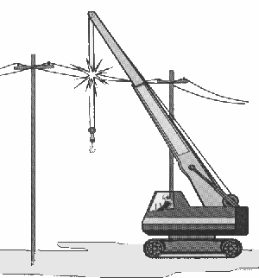
  Crane Use Near Power Lines
Boom or crane contact with energized power lines accounts for nearly 45% of crane accidents.
Source: NIOSH
Notes:
Crane use near power lines
Workers are killed each year when cranes contact overhead power lines.

Slide 19
  Crane Use Near Power Lines
Pre-operational requirements:
Identify work zone
Determine proximity to power lines, if closer than 20 feet, if so, must do one of the following three:
  De-energize and ground
  Ensure no part of equipment, load line, or load gets
  closer than 20 feet to power line
  Determine line’s voltage and minimum approach distance
  permitted under Table A.

Slide 20
  Crane Use Near Power Lines
Pre-operational requirements:
TABLE A – MINIMUM CLEARANCE DISTANCES
Voltage (nominal, kV, alternating current) | Minimum Clearance Distance (feet)
up to 50 | 10
over 50 to 200 | 15
over 200 to 350 | 20
over 350 to 500 | 25
over 500 to 750 | 35
over 750 to 1,000 | 45
Over 1,000 | (as established by the utility owner/operator or qualified registered professional engineer who is a qualified person with respect to electrical power transmission and distribution)
Notes:
Crane use near power lines
Identify work zone
Determine if any part of crane, load line, or load could get closer than 20 feet to a power line if operated at maximum working radius in the work zone. If so, must meet requirements in one of three options:
De-energize and ground
Ensure no part of equipment, load line, or load gets closer than 20 feet to power line
Determine line’s voltage and minimum approach distance permitted under Table A.

Slide 21
  Employer Requirements
Comply with all applicable employer requirements.
Designate a competent person to inspect all machinery and equipment prior to each use.
Notes:
Employers are required to:
A. Comply with all applicable employer requirements related to:
Assembly/Disassembly of crane
Power line safety
Procedures applicable to the operational functions of equipment, including attachments
Qualifications/certifications of:
Crane operator
Signal person
Rigger
Other applicable OSHA requirements, including
Training requirements
Inspections requirements
B. Designate a competent person to inspect all machinery and equipment prior to each use and during use, to make sure it is in safe operating condition.
C. Comply with manufacturers’ requirements and recommendations for cranes and related equipment.

Slide 22
  Training Requirements
Employer must provide training
Training administration
Notes:
Employers must provide training:
Overhead power lines
Signal persons
Operators
Competent persons and qualified persons
Crush/pinch points
Tag-out
Training Administration
Evaluate employees’ understanding of information provided in training
Provide refresher training
Provide training at no cost to employee

Slide 23
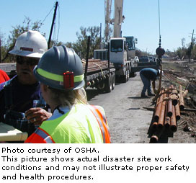
  Hazard Recognition
Notes:
Fall Hazards
Struck-by Hazards
Crushing Hazards
Electrical Hazards
Source: OSAH (https://www.osha.gov/SLTC/etools/hurricane/crane-use.html)

Slide 24
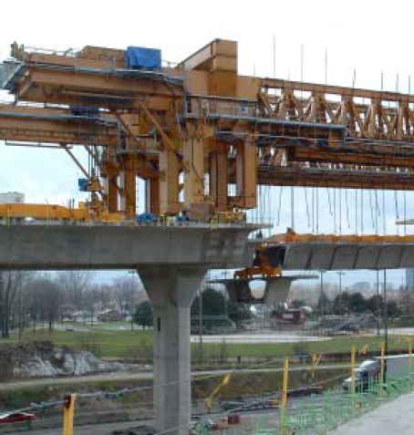
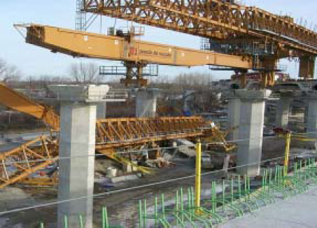
  Hazard Recognition
Photo source: OSHA
Notes:
For this particular design, the manufacturer required the use of four anchoring bars for each of the four rear legs (sixteen total anchoring bars) and two anchoring bars for each of the two telescoping front legs (four anchoring bars total). The anchoring bars in the rear were designed to be pre-stressed to 600 kilo-Newton's per bar (approximately 135,000 pounds of force per bar) to provide resistance to the longitudinal and transversal forces primarily during the launching of the under-bridge. The front leg anchors were to be pre-stressed to resist transversal forces, such as those created by wind.
The accident investigation revealed that the employer had not designed the pier segments to accommodate each of the anchoring locations, reportedly because of congestion in the segments with other items such as stressing cables. It was further determined that the employer used only a few anchoring bars during the initial launches and as work progressed began using fewer and fewer anchoring bars. On the day of the accident, there were no anchoring bars for the four rear leg and only one anchoring bar in each of the front legs. Additionally, the front leg anchors had not been stressed to the appropriate force and were only tightened with a wrench. A few months prior to the collapse of the launching gantry, the employer had experienced a movement of about 2 centimeters at the rear legs during a launch when using a total of only two rear-leg anchoring bars. The manufacturer's instructions provided that such movement could lead to a collapse of a launching gantry.
Source: OSHA (https://www.osha.gov/dts/shib/shib050106.html)

Slide 25
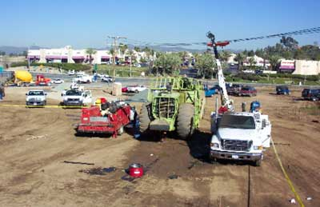
  Hazard Recognition
Photo source: NIOSH
Notes:
Two heavy equipment mechanics, an 18-year-old male and a 40-year-old male, died when electrocuted while working on a scraper. The scraper was at a construction site parked under a high voltage line. The victims were using the truck-mounted crane on one of their service trucks to assist in replacing the rear differential when the incident occurred. The crane’s boom made contact with the high voltage line. The control for the crane was a remote unit electrically wired to the truck. The 18-year-old victim was operating the crane at the time of the incident. The California Fatality Assessment and Control Evaluation (CA/FACE) investigator determined that, in order to prevent future occurrences, employers, as part of their Injury and Illness Prevention Program (IIPP), should:
Ensure heavy equipment mechanics know the safety and health hazards specific to their job assignments.
Ensure all employees perform safety and health inspections prior to starting their job assignments in order to find, eliminate, or control safety and health hazards as well as unsafe working conditions and practices, and to comply fully with the safety and health standards.
Ensure all employees are provided with mechanical and physical safeguards to the maximum extent possible in order to perform their job assignments safely.
Ensure heavy equipment mechanics are properly trained on machine operation and safety and their achievement of skills is verified through a testing program.
Source: NIOSH: Fatality Assessment and Control Evaluation (FACE) Program – California Case Report 04CA004 (http://www.cdc.gov/niosh/face/stateface/ca/05CA011.html)

Slide 26
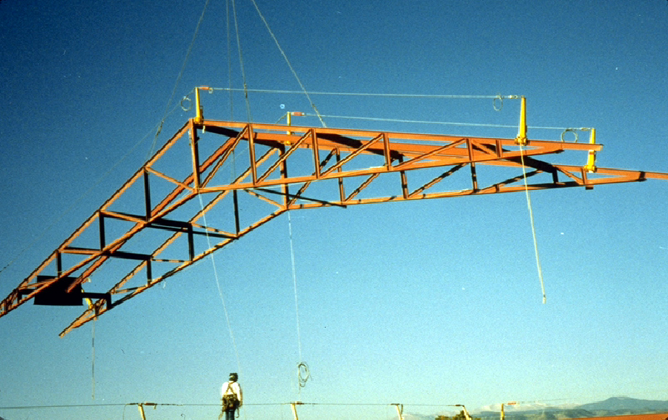
  Hazard Recognition
Photo source: OSHA
Notes:
Don’t stand under suspended loads. Keep the load as close as possible to the ground when picking and carrying a load.
1926.1425(b) While the operator is not moving a suspended load, no employee must be within the fall zone, except for employees:
1926.1425(b)(1)
Engaged in hooking, unhooking or guiding a load;
1926.1425(b)(2)
Engaged in the initial attachment of the load to a component or structure; or
1926.1425(b)(3)
Operating a concrete hopper or concrete bucket.

Slide 27
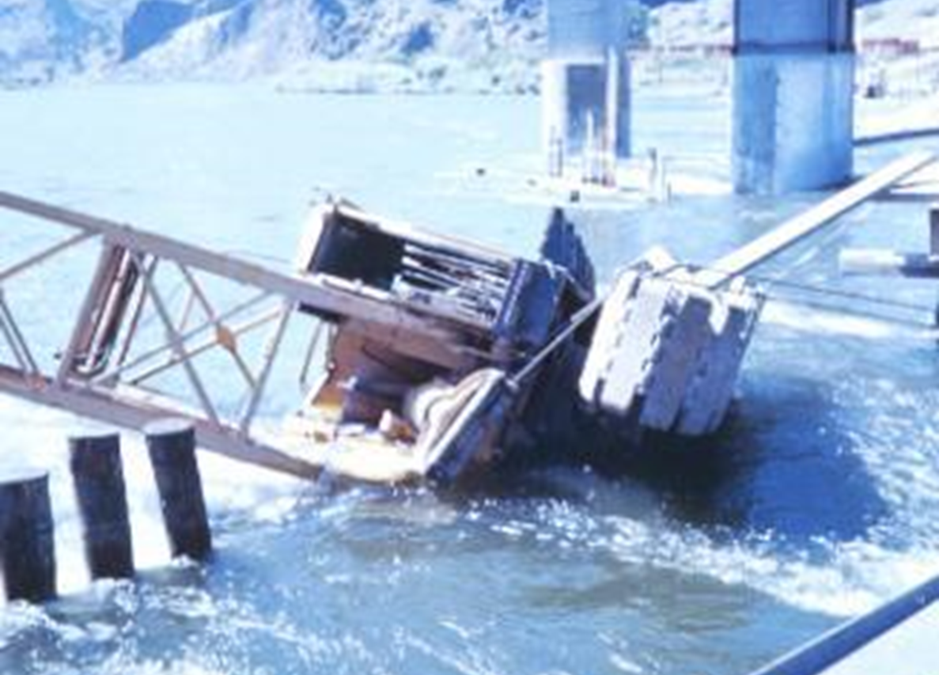
  Hazard Recognition
Photo source: OSHA
Notes:
Improper loads or speeds can result in the tipping of the crane.
CRANE ACCIDENT – OVERTURNED CRANE
This crane overturned while performing loading operations on a pier. The crane was attempting to remove a metal container from a barge when it tipped and slid into the water. The wind caused the load to swing violently causing the load to go outside the swing radius, at that point the load dropped into the water and took the crane with it.
See Fatal facts for descriptions of fatal crane accidents at www.osha-slc.gov/OshDoc/toc_FatalFacts.html

Slide 28
Knowledge Check
Nearly 45% of crane accidents are the result of the boom or crane making contact with __.
  other cranes
  work zone barricades
  energized power lines
  workers on the ground
  c. energized power lines

Slide 29
Knowledge Check
Before beginning equipment operations, the employer must ___.
  identify the work zone and determine proximity to power lines
  notify utility company of lift and estimate voltage of power lines
  locate the fall zone and test load by lifting it at least 20 feet off the ground
  remove hazard area barriers and observe weather conditions
a. identify the work zone and determine proximity to power lines

Slide 30
Knowledge Check
A broken window that distorts the operator’s visibility of the task is acceptable for operation.
  True
  False
b. False

Slide 31
Knowledge Check
Which of the following must be readily available to the crane operator for use at all times?
  Load charts and recommended operating speeds
  Special hazard warnings
  Instructions and operator’s manual
  All of the above
d. All of the above

Slide 32
Knowledge Check
Who is responsible for inspecting all machinery and equipment prior to each use and during use, to make sure it is in safe operating condition?
  Certified person
  Qualified person
  Proficient person
  Competent person
d. Competent person

